Slide 1
Adventures in Resource Sharing: the AspenCat Story
Colorado ILL Conference 2016
Bob Bennhoff and Ashley Sneesby-Stippich
Notes:
Bob
Running a large Colorado based ILL organization made attending last year’s conference a fit
Much was learned from conversing and attending
We would like to share our story which we hope will tell the value of resource sharing, provide insight into our work to make that sharing easy, and speak to some things we’ve learned that should be transferrable to your work

Slide 2
Things to consider…
ILL transforms libraries
Resource sharing serves and creates a network of libraries with a shared purpose
Access to shared materials depends on the quality of the catalog
Behind the scenes customer service is essential to patron satisfaction
Notes:
Bob
ILL transforms libraries
Resource sharing serves and creates a network of libraries with a shared purpose
Access to shared materials depends on the quality of the catalog
Behind the scenes customer service is essential to patron satisfaction

Slide 3
Once upon a time in Library Land…
Notes:
Bob

Slide 4
What is AspenCat? What is Koha?
Union Catalog
Web-Based ILS
Open Source
Hosted
Part of Colorado Library Consortium (CLiC)
Notes:
Bob
Union Catalog
AspenCat is a shared library system “ILS” with over mostly rural 100 participating libraries.
All libraries share the same catalog, as if people used prospector solely as their catalog
Web Based ILS
Not software to load on a computer, but accessed via a secure connection through a web browser
This provides additional flexibility for those that use it
Open Source
Began as a true open source system, cobbled together ad hoc by various library developers
Not truly open source now, but provides a model of pay for development that allows for customization
Hosted
PTFS does all the development work and hosts our data on their servers
This allows for AspenCat to function with a small staff that focuses on working with libraries directly
CLiC
Known primarily because through courier services
Provides other services for CO libraries including cooperative purchasing, continuing education, consultant services, and AspenCat!

Slide 5
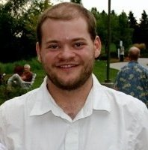
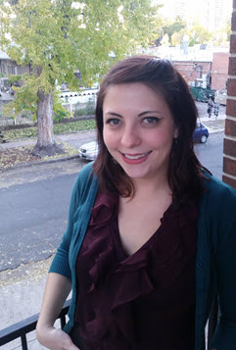
Notes:
Ashley
CLiC’s mission is Connecting. Energizing. Inspiring through services for libraries throughout Colorado. AspenCat is an important piece of this mission because AspenCat is more than just a catalog, it is a network of libraries and services provided by CLiC and administered by the AspenCat Team who issssss….
Bob Bennhoff: ILS Services Manager
Ashley Sneesby-Stippich: ILS Consultant
Jo Hunter: ILS Support
Plus lots of support from other CLiC staff

Slide 6
The Libraries of AspenCat’s Realm
Notes:
Ashley
AspenCat represents multi-type libraries including public, combined school-public, school, and academic across the entire state of Colorado
Primarily small and rural libraries, as represented on this map

Slide 7
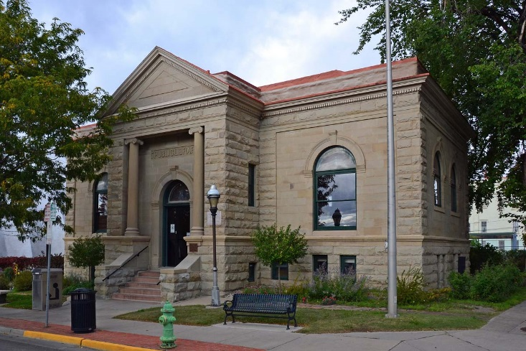
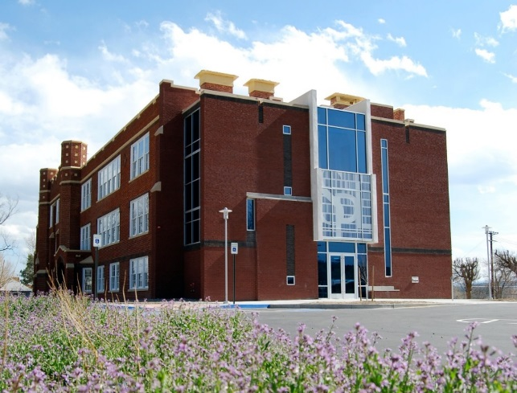
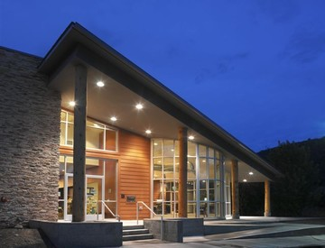
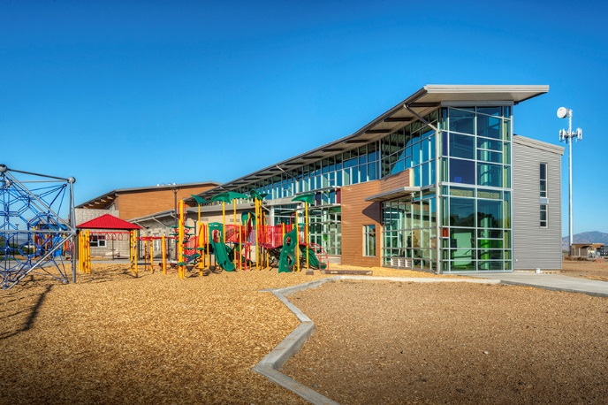
Some of our Library Strongholds
Notes:
Ashley
This is just a small representation of some of the beautiful libraries that make up the realm of AspenCat.
Two Carnegie libraries, one in Trinidad and the other in Silverton.
Some newly remodeled and built libraries in Mancos, Dolores and Moffat.
A public school building converted into a public library in Walsenburg.

Slide 8
Presenting our story’s hero… Resource Sharing!
Provides a breadth of collection for small libraries with limited resources and budgets
Improves the value of collection development funds
Creates an active network between rural Colorado libraries
Notes:
Ashley
Breadth of collection for all libraries
Tiny libraries have access to holdings amounting to the size of a major urban library system
Puts materials in the hands of patrons!
Being on a shared system shortens typical ILL wait times, making the process easier for patrons and staff alike…get things quickly. Processes are simplified on the back end.
Affects collection development
Money can be spent on materials that are actually in demand because of resource sharing for materials such as classics or niche items
Libraries increase their relevancy to patrons by having the chance to make purchases that meet their communities’ needs
Variety of library types increases access to materials that patrons might not usually have access to due to collection, budgetary or geographical restraints
Academic library patrons have access to popular leisure materials, public library patrons have access to academically focused materials, school libraries have access to both types of items they usually don’t have budgets to purchase
Popular visual materials for communities without stable Internet/streaming access…increases use of libraries even in small communities because they put relevant materials in the hands of patrons.
Creates an active network between rural Colorado libraries with shared purpose and needs
Opens the door to conversations about information organization and overarching library practices for individuals not familiar to the field
Not only about item sharing. Libraries make connections with similar institutions with similar issues and strengths

Slide 9
The AspenCat Kindgom’s Collection Coffers
Average AspenCat library has ~15,000 total items
1.3 Million items in entire AspenCat collection
8,500 percent increase of collection size!
Notes:
Ashley
AspenCat libraries patrons have access to 1.3 million physical items (DVDS, Audiobooks, Books) thanks to resource sharing
In comparison to major urban library system: DPL has 1.3 million print volumes, JeffCo has 727K print volumes (LRS Data, 2014)
SWIFT is still a valuable and used service for AspenCat libraries, though it’s no longer the primary source of ILL because of the growing breadth of the AspenCat catalog

Slide 10
The AspenCat Kingdom Expands
Libraries Joining
Notes:
Bob
How did we reach over a million materials?
AspenCat has tripled in size between 2013 and 2016, growing by 63 new libraries in a three year period
A majority of this growth was a major migration 22 libraries who were previously part of Nexus Library Group in Southeast Colorado,
This rapid growth has helped out a lot of libraries by increasing what they offer patrons, but has created some catalog based challenges that we will talk about soon
Another type of challenge has been to maintain the same level of service throughout and post expansion without adding new staff
Increasing documentation, finding efficiencies in our work, and leaning heavily on CLiC regional consultants has been essential

Slide 11
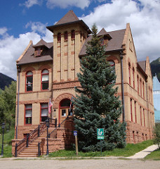
Our Hero Aids Three Libraries!
Notes:
Bob
Dolores County Libraries (two combined public-school libraries) and Rico Public Library (public)

Slide 12
The lay of the land between…
Notes:
Bob
71 miles and a mountain pass separate these two libraries
Both are categorically ‘remote’ from both one another and other peer libraries in the area
Previously, Rico patrons had to travel to Telluride for ILL’d materials, AspenCat has put these on their own doorstep

Slide 13
Our Hero Aids Three Libraries!
Major growth in collection size
Functioning and well supported ILS
Access to relevant eResources better serves patrons
Joining AspenCat has connects the libraries to the larger library community
Notes:
Bob
Major growth in collection size – 37,000 for all three combined to 1.3 million
Now have a functioning and well supported ILS with…
Responsive customer support
Robust reporting
Complete cataloging module
Small-budget friendly price
Access to relevant eResources serves their patronage
ACDC Overdrive and Cloud Library
Cloud Library, which was funded by LSTA and now is run on pledges from AspenCat Libraries
Database packages offered through CLiC
Joining AspenCat has connected them to larger library community

Slide 14
Our friendly and cute sidekick… PIKA!
Notes:
Ashley

Slide 15
Notes:
Ashley
Addition of Pika to improve accessibility and modernize the catalog (Partnered with Marmot Library Netw
Previous OPAC with Koha didn’t encourage easy use of the catalog for patrons
We knew a quality discovery layer would be beneficial for all parties
Items easier to find both online and in house for patrons
Familiar aesthetic to other popular web services; friendly online and in-house catalog experience
Visual interface with lots of usability for novices and experienced users
Browseable!
Displays the breadth of the catalog and materials that are available as part of AspenCat
Easily customizable for libraries in a number of ways, which meets some standard our libraries have come to expect but in a more forward facing way
Unique browse categories are relevant to the community’s interests
Quick way for libraries to push out special and relevant materials
Library logos, banner pictures, even color schemes

Slide 16
Notes:
Example of search results and interface of the Koha OPAC.
“Harry Potter and the Goblet of Fire” search returns 39 different results, with no visual representation or regard for different item types with a simple keyword search.
Requires the patron to understand the underlying framework to place a good hold, determine the item type of the bib and navigate the process of placing a hold

Slide 17
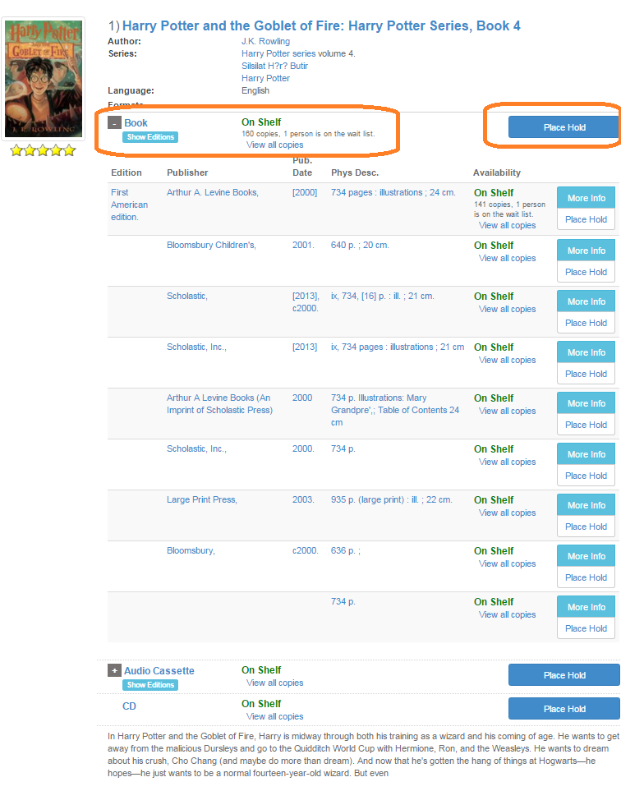
Notes:
Ashley
“Grouped works” that collect and display individual bibs in more accessible ‘groupings’
Groups works by title and then by item type
Gives preference to the local item immediately, which is helpful for staff, as locally available items go out first and holds are placed on items that actually need to come in from other libraries
Search results are easier to read, but still allow for specificity for the advanced user, as referenced on the expanded screenshot on the right.
Easy for advanced and novice patrons alike with predictive searching, intuitive keyword searching, and easily identifiable item types
Patrons don’t have to sift through multiple bibs to find what they’re looking for
System places the best hold, making for quicker ILL times behind the scenes
System makes placing holds for outside items particularly easy, promoting resource sharing between AspenCat libraries

Slide 18
Notes:
Ashley
More seamless integration of eContent
Overdrive and Cloud Library
API for Overdrive allows for checkout directly from the OPAC
Cloud Library materials visible and easily accessed directly from the catalog
Greater access to breadth of all types of materials for all libraries
Another avenue for connection with area library districts
Virtual ILL! With shared eConent between AspenCat, ALD, Montrose, Ft. Morgan
Connections originally established through ILL between AspenCat libraries and other non AspenCat systems has developed into functional partnerships for electronic materials
ILL CONNECTS US!

Slide 19
Every hero needs their…
Notes:
Ashley

Slide 20
The Sword of Catalog Maintenance
Messy catalog = Poor access for patrons/librarians
Brief and duplicate records are the enemy
White Knight is Skyriver
Ongoing hands-on training
Notes:
Bob
Messy Catalog
Makes things hard to find
Doesn’t matter how many items you are able to borrow if access is difficult
Brief and Duplicate Records
Brief records
Many newly migrated records were not robust or created duplicates in the system, partially because Nexus libraries lacked the ability to do their own cataloging in-house
Updating to have more access points for users to discover and access items
Duplicate Records
Creates a sea of records that is difficult to navigate
We can use automated processes to “dedup”, but they aren’t perfect
Pika tries to group these to hide our mess, but isn’t magic
Easy merging of records was a development we added recently that makes cleaning these up possible
Skyriver
Previously there was no consistent source of quality or breadth of records
Within Koha it is easy to import these records for newly cataloged items and to fix mistakes
Providing Hands on Training
Few AspenCat libraries can get either trained or experienced catalogers
In-person and remote web-based trainings
Developing a process to evaluate cataloging work of library staff to ensure good cataloging practices
Bringing in outside help to assist with tonnage of manually change records
600,000 total records means an error rate of 1% requires 6,000 records to be cleaned up
Remember - Better records, Better access!

Slide 21
The Shield of Standardization
“Collection Audits” to aid in clean up
Eases cataloging and circulation issues for AspenCat as a whole
Libraries participate in an open dialog about information organization and the needs of small and rural libraries
Notes:
Ashley
Eases cataloging and circulation problems
Standard item types, shelving locations, and patron types
Previously had over 200 shelving locations and an overabundance of patron types and item types
The breadth of choices was confusing for working staff, and led to poor choices being made as items and patrons related to actual in-house use
Less mistakenly chosen coded values keep things straight forward for a variety of library staff with varying experience
Providing libraries with ‘Playbooks’ of correct coded values, making their work easier
Circulation problems corrected because libraries are using standard patron and item types, which circulation rules are based on
For example, DVDs might have different circulation rules than books
Creates a good workflow for libraries who have standards to work by going forward
Method by which to discuss the overarching collection more closely with libraries and create an open dialog for both us and CLiC regional consultants about information organization, in-house needs, and issues germane to rural/small libraries
An audit encourages a library to take a closer look at their collection, how items are being classified, and how their patrons are using them as well as reevaluating in-house processes and updating these to meet their current needs

Slide 22
Serving the Kingdom
Good customer service should be universal
The AspenCat model is based on trust
Customization is important, even in a consortial setting
The key to our kingdom is communication
Notes:
Bob
Our customer service model = TRUST
Working with the people that work with patrons
Understanding their work
Transparency and encouragement of library contact helps with resource sharing issues and problems
Customization is important, even in a consortial setting
Offering clear guidelines and recommendations is helpful in achieving customization with standardization
Communication is key
Offer a variety of ways for libraries to communicate with us.
Give our libraries a voice in the form of committees, frequent meetings, and a dedicated listserv
Responsive one-on-one communication with the AspenCat team at the point of need
You do this, too!

Slide 23
ILL staff does this, too!
Notes:
Bob
You work with front line staff to serve patrons
You need to understand what staff does and why and translate that into good service for patrons
Staff should understand your work and how important it is to getting materials into patrons hands to better serve your community
This is a relationship of trust between ILL and frontline library staff, built through good communication and responsiveness
In the end, it’s about serving the patron and the better that frontline and ILL staff work together, the better the patron is served.

Slide 24
Morals and Happily Ever Afters…
ILL is noble work
It changes patrons’ lives in libraries big and small
Small teams can accomplish big things
Access is increased with a well maintained database and user-friendly OPAC
Build trust, communicate, and provide great customer service even in challenging situations
Notes:
Ashley
ILL is noble work
It changes patrons’ lives in libraries big and small
What you do aids patrons you may never meet
Your work makes information accessible to people at their point of need!
Small teams can accomplish big things
We’ve handled major projects and support for over 100 libraries with 3 people because we communicate and work together toward our goal of providing great service
Having a clean database and quality OPAC increase access
Maintaining and supporting your tools help you provide good customer service
Build trust, communicate, and provide great customer service in all instances
When you provide the best service you can, you help support your library’s mission, which supports your community!

Slide 25
Questions?
Please email us at:
bbennhoff@clicweb.org
asneesbystippich@clicweb.org

