Slide 1
Models of Resource Sharing Colorado Alliance
George Machovec
Executive Director
Colorado Alliance of Research Libraries
May 1, 2015
46th Annual Colorado ILL Conference

Slide 2
Colorado Alliance of Research Libraries
Incorporated in 1981
14 member libraries (13 academic, 1 public) – one out of state library (University of Wyoming)
Programs include
E-resource licensing – 250 contracts (>$14 million)
Prospector union catalog – 44 libraries, 13+ million unique MARC records
Gold Rush (ERMS)
Digital Repository Service – winding down central consortial management to return to local library management (Fedora/Islandora). But still operate ArchivesSpace and looking into DPLA service hub with the state
Shared Print (launching later in 2015)

Slide 3
Resource Sharing in the Colorado Alliance
Prospector
Gold Rush
Shared Print Program

Slide 4
Prospector
Union Catalog for 44 libraries in Colorado and Wyoming
Launched in 1999
Uses INN-Reach software from Innovative Interfaces
A central union catalog with 14 million unique titles with 33 million items
~600,000 lends per year
Can interface with any brand of integrated library system
New standards-based API to be available at the end of 2015

Slide 5
Prospector – What’s New?
Have added approximately 1 million public domain ebook records from HathiTrust
Have linked Prospector with MOBIUS in Missouri (program earlier in the conference on this)
Adding of non-Innovative libraries at price point comparable to those with III systems

Slide 6
INN-Reach Environment
Sierra
Millennium
INN-Reach
Central
DCB
Notes:
Automatic and real-time updates (e.g. additions to collection, modification of circulation status) keep the INN-Reach Union Catalog in sync with local systems.

Slide 7
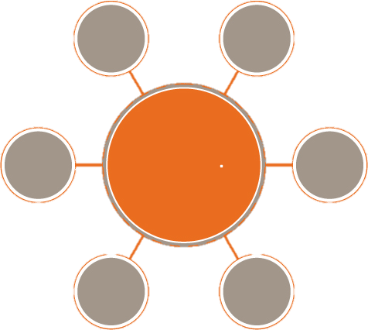
Peer to Peer Environment
MOBIUS
Prospector
Notes:
All works in the same way as if the patron started their search in their local library catalog. If the patron is unable to find available copies or is unable to locate the resource in their primary network, they have the option of passing the search to the secondary network.

Slide 8
Peer to Peer Requesting
Both systems maintain their own union catalog
Local branding and identity remain (very important politically)
All patrons can request equally from either union catalog
A link from each union catalog allows patrons to move to the other system transferring searches
Patrons can use their local library card to authenticate in the other system
Staff receive and process requests from both systems in the same way

Slide 9
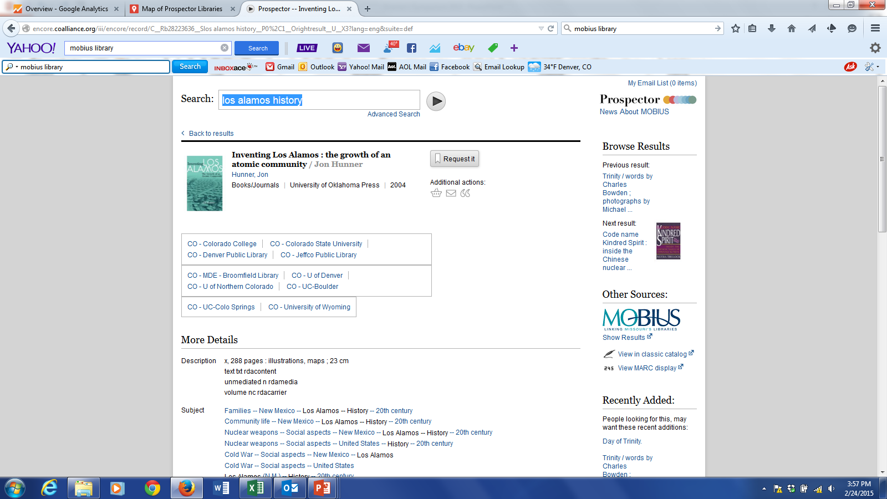

Slide 10
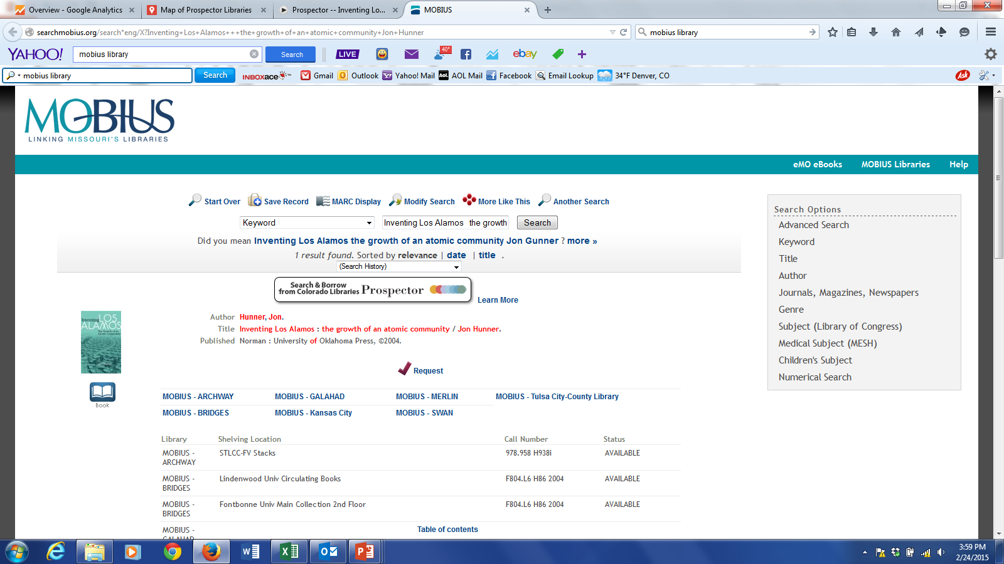
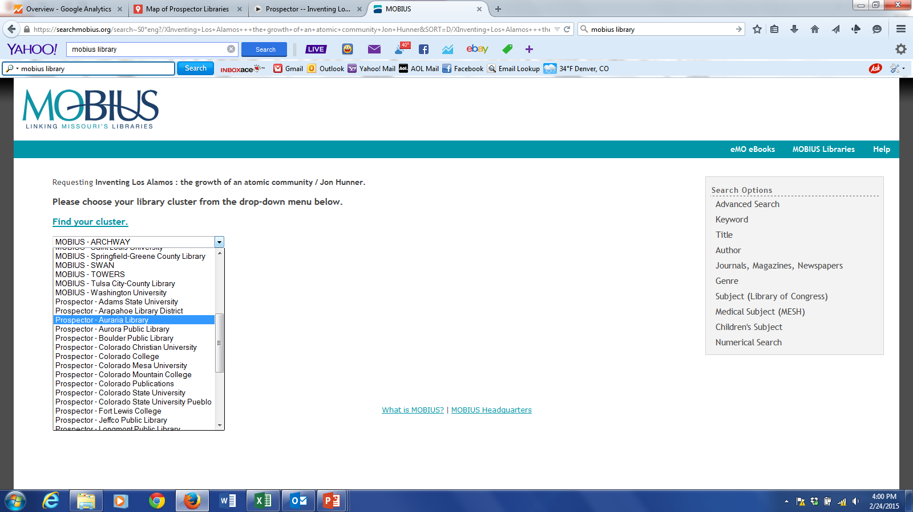

Slide 11
Why INN-Reach & Peer-to-Peer?
Working with trusted regional partners
Familiar patron-initiated requesting
Low cost borrowing in recent study at Colorado State University ($0.45/item)
Includes all materials that libraries want to share no matter what the source of cataloging records (OCLC, SkyRiver, vendor supplied)
Can include catalogs of any brand not just the Innovative products (Sierra, Millennium, Polaris, VTLS)
Can be the umbrella tying a heterogeneous region together
Forthcoming API will allow easier and less expensive non-Innovative integration

Slide 12
Gold Rush
Originally developed in 2003
ERMS (Subscription Management) at the consortial or local library level
Link Resolver
A-Z
Journal comparison tool (publishers, aggregators, indexing/abstracting)
Used by about 50 libraries/consortia in North America
Fully maintained knowledgebase
Some use the complete system but many license just the part they need at a price point well below commercial counterparts
Journal comparison tool available “free” to call libraries in Colorado due to a contract with CLiC!

Slide 13
Shared Print Program
The Colorado Alliance has launched a Shared Print program for monographs and serials
Ensure discovery, access and delivery of legacy print holdings
Make informed decisions on moving materials to storage or weeding
Discovery and delivery through a regional union catalog (Prospector)
Agreements modeled on work by ConnectNY, Orbis Cascade Alliance, Sam Demas and others
An analysis tool was needed that was affordable and flexible
Commercial tools (Intota Assessment, OCLC Collection Evaluation, SCS) where quoted at subscriptions which were too expensive for 14 member libraries

Slide 14
Comparison Tool Selected Characteristics
Must be scalable to include the largest libraries
Must work in real-time
Must support comparing any combination of libraries (1-1, 1-many, many-many)
Must support export of MARC, XML and delemited (Excel)
Must show what’s unique and overlapping, including visualizations
Must be able to have searches or facets to work with any fields in a MARC record
Matching algorithm must be made from elements in a MARC record but NOT depend on OCLC #, ISBN, ISSN
Must be easy-to-use!

Slide 15
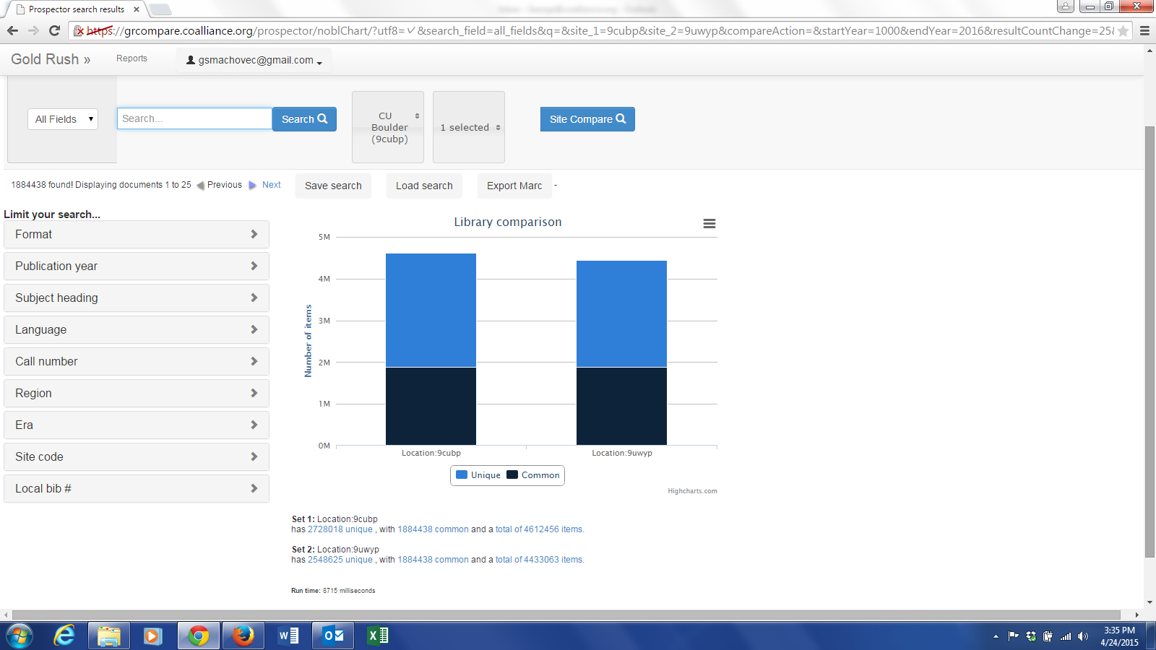
Simple comparison of two large academic libraries with no special limiting. Each with greater than 4 million records. University of Colorado vs. University of Wyoming
At this level mostly useful for bragging rights!

Slide 16
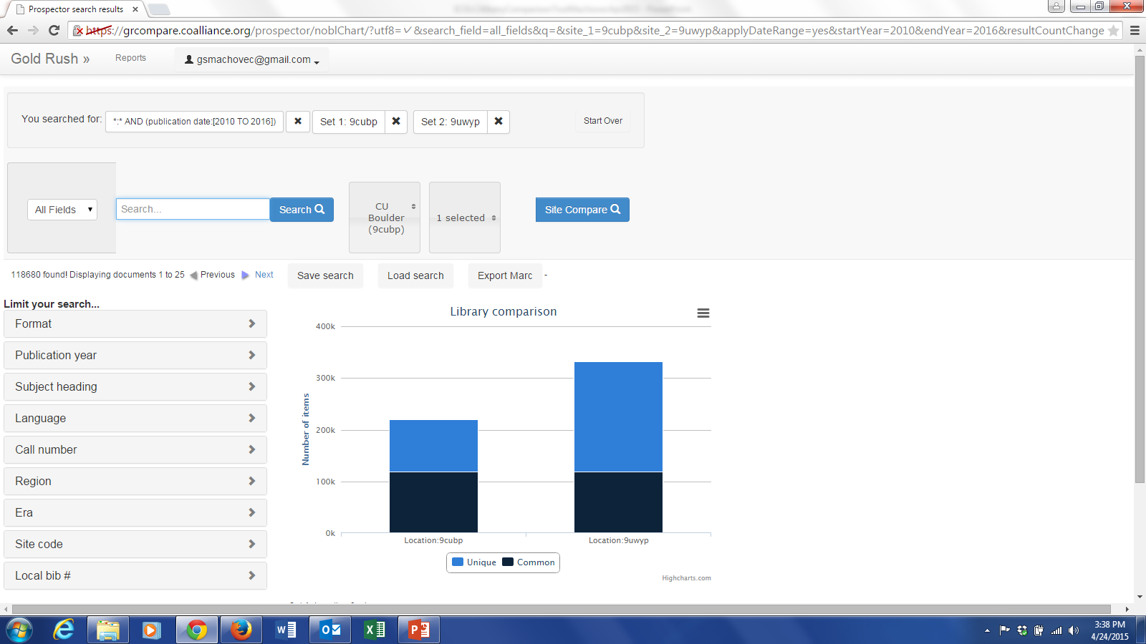
Same two libraries but limited to the last five years. Showing which library is currently doing better in growing their collection.

Slide 17
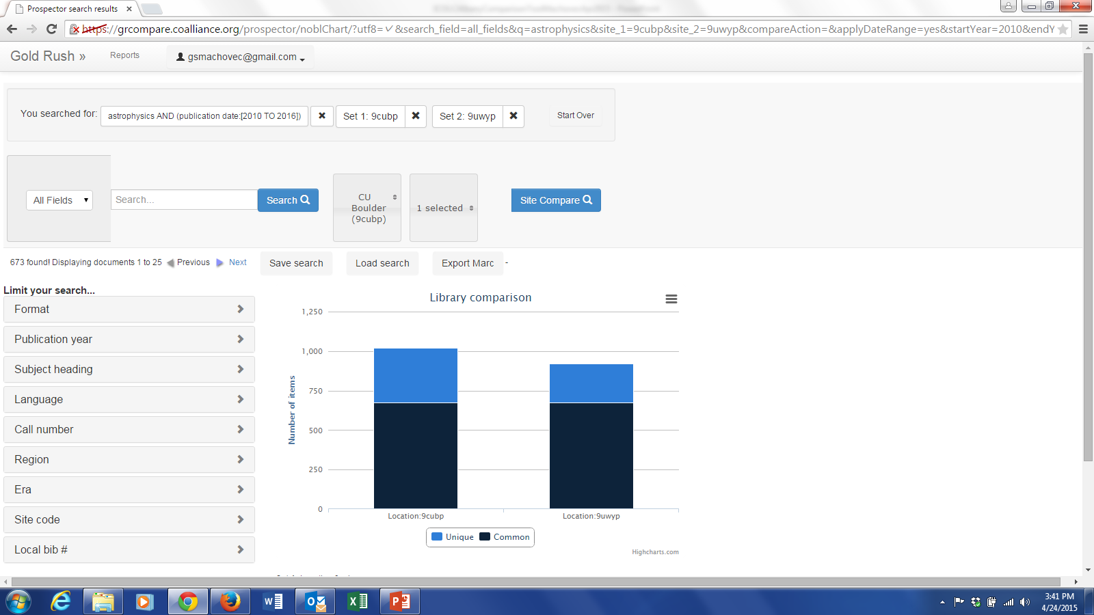
Can save searches and export records in MARC, XML and delimited formats
Same two libraries but limited to “astrophysics” materials added in last 5 years.

Slide 18
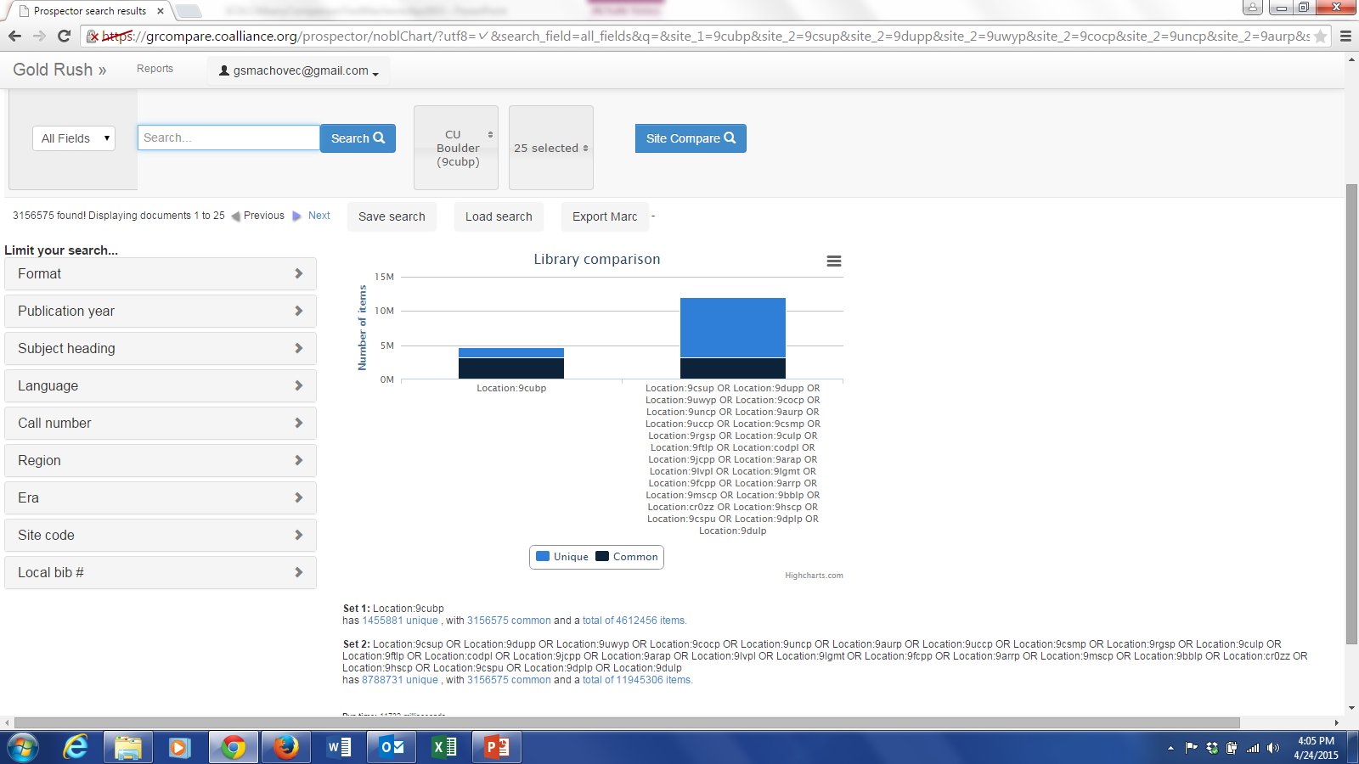
University of Colorado at Boulder compared to 25 other libraries with no limiters! Comparing 4.6 million MARC records to almost 12 million MARC records in seconds

Slide 19
Challenges Faced in the Project
Making the user interface (UI) easy and intuitive
Getting the matching algorithm right
Too tight we end up with too many orphans that should have matched
Too loose we end up with false merges
Sometimes libraries want e-resources to match with print and sometimes they don’t
Making it all happen in real-time and scalable to any library size (accomplished)

Slide 20
Work Yet to be Done
Interest in adding additional datasets such as HathiTrust public domain items, commercial ebook sets, etc.
Adding branch and location level metadata for doing comparisons within a library system (particularly important for public libraries)
Adding new facets as requested by users
Doing longitudinal collection analysis over time (imprint dates)

Slide 21
Sample Use Cases
Shared print programs
What to put in storage
What to weed
Getting a set of unique records and adding a 583 retention note
Adding a new program on campus and want to compare holdings with an established institution with the same program
Want to compare branches in a public library system
Comparing collection with commercial datasets or other catalogs (e.g. HathiTrust, CRL)
Quick exports for participation in other cooperative programs
Bragging or complaining with your colleagues or administration!

Slide 22
What’s Next
The tool is in beta with all of the heads of collection development at the Colorado Alliance libraries
Available free to all Prospector libraries!
We will offer it to libraries elsewhere at a very low cost. However, we do need to charge a fee since it takes a fair amount of work to load metadata and keep it all running.
Let me know if you might be interested down the road
Ready for broader public release in July 2015!

Slide 23
Questions?
George Machovec
Colorado Alliance of Research Libraries
george@coalliance.org

