Slide 1

My Library is a Real Library Because of ILL
46th Annual Colorado Interlibrary
Loan Conference
John Chrastka
@mrchrastka @everylibrary

Slide 2
EveryLibrary is the first national political action committee for libraries.
We help build voter support for library funding.

Slide 3
About EveryLibrary
Built as a 501c4 to do training and coaching for staff and boards on Information Campaigns
AND to support “Get Out the Vote” and
Vote YES by local ballot committees.
Donor supported pro-bono advising and consulting.

Slide 4

Since September 2012:
26 campaigns
20 wins
over $46.2 million in stable tax money for libraries
Average donation is $48.50
ROI of $1 : $1600

Slide 5
What have we learned?
Five huge things about voter, funder, advocate, and constituent behaviors:

Slide 6
What have we learned?
Voter behavior is driven by “belief in” and “nostalgia about” libraries. Use doesn’t matter.
- 37% solid, 37% swayable, 25% no

Slide 7
What have we learned?
Voter behavior is driven by “belief in” and “nostalgia about” libraries. Use doesn’t matter
- 37% solid, 37% swayable, 25% no
Voters look to the “passionate librarian” as much as the “effective institution”.

Slide 8
What have we learned?
Voter behavior is driven by “belief in” and “nostalgia about” libraries.
- 37% solid, 37% swayable, 25% no
Voters look to the “passionate librarian” as much as the “effective institution”.
Voters are consumers.

Slide 9
What have we learned?
Voter behavior is driven by “belief in” and “nostalgia about” libraries.
- 37% solid, 37% swayable, 25% no
Voters look to the “passionate librarian” as much as the “effective institution”.
Voters are consumers.
Marketing works.

Slide 10
What have we learned?
Voter behavior is driven by “belief in” and “nostalgia about” libraries.
- 37% solid, 37% swayable, 25% no
Voters look to the “passionate librarian” as much as the “effective institution”.
Voters are consumers.
Marketing works.
Opposition must be engaged.

Slide 11
What does this mean for resource sharing and ILL?

Slide 12

My Library: Berwyn Public Library

Slide 13
My Library: Berwyn Public Library
55,000 service population / 28,000 cards
$2.9 million tax revenue
$2.3 million is staffing
$266k on materials / $4.83 per capita
235,625 visits w/ 25k attending programs
*2014 BPL IPLAR

Slide 14
BPL - Collections
95,384 books
322 magazines
12,015 cds
11,853 dvds
38 licensed databases
328,973 = Total number of materials loaned

Slide 15
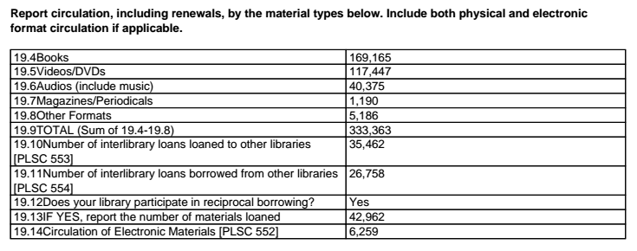
BPL - Plus

Slide 16
Interlibrary loan and resource sharing
makes my library
43% bigger

Slide 17
What Nobody Knows, Matters
How do we tell our story?
Who do we tell it to?

Slide 18
The Illinois Systems Story
May 2010:
“Anne Craig, director of the Illinois State Library, "that the financial picture in Illinois is very dire. There is no money! System funding has been vouchered to the Comptroller’s Office, but when it will be released is unknown. The State Library has a total of 1,277 vouchers being held in the Comptroller’s Office that total $24 million. This includes the Public and School Per Capita Grant awards. Ms. Craig instructed the library systems to focus on two services, delivery and LLSAP [Local Library System Automation Program]. If there is any money left, then other services can continue."”
American Libraries Magazine, 5/19/10

Slide 19
The Illinois Systems Story
December 31, 2010 deadline
$12 million shortfall
Budgeted and allocated, but “stuck”
What unsticks?

Slide 20
What Nobody Knows, Matters
How do we tell our story?
Who do we tell it to?

Slide 21
This Guy

Slide 22
How do we tell our story?
Traditional ILL and Resource Sharing Stories:
Get everything you want
Your library is bigger
We’re sharing!

Slide 23
How do we tell our story?
Colorado Library Courier
The Colorado Library Courier is a service of the Colorado Library Consortium (CLiC) that delivers interlibrary loan materials between member libraries within the state, and connects member libraries to the courier networks of other states. Managing the courier system is one of the ways CLiC meets its goal to expedite the discovery, selection, and delivery of information and materials to library patrons in Colorado.
Courier Facts
Serves more than 380 libraries in Colorado
Makes more than 13,800 stops a week
Drivers cover 14,000 miles a day
Delivers ~6 million items a year
Costs, on average, about $0.25 to $1.00 per item

Slide 24
Four New Stories
Logistics Solutions Provider
Big Data Enterprise
Sharing Economy at Scale
Open Source Community

Slide 25
How do we tell our story?

Slide 26
Policy Solutions You’ve Created by Being Awesome
Local taxes are not used locally
  Sure, we’ll borrow but….
  Remote circulation is like a donation….
  Pick up anywhere means we’re serving “not us”...
  24/7 reference is suspicious...
You don’t honor borders
  Municipal
  State
  National

Slide 27
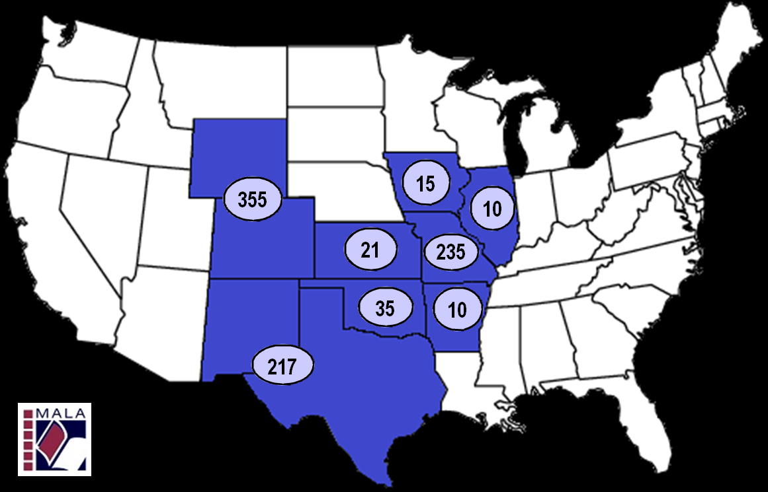
You have created the first truly “supra-jurisdictional” public entities in the USA

Slide 28
Four More New Stories
Regional Taxing and Development Authority
Leverage for under-resourced educational institutions
Data driven, responsive local government
Data driven, efficient, and progressive

Slide 29
What have we learned?
Voter behavior is driven by “belief in” and “nostalgia about” libraries. Use doesn’t matter.
- 37% solid, 37% swayable, 25% no
3. Voters are consumers.

Slide 30
E-Commerce Giants Are Battling To Own The 'Last Mile'
“Companies like Google, Amazon, eBay, and Uber are operating and expanding services that allow shoppers to order something online and have it that same day, without ever leaving home.”
http://www.businessinsider.com/e-commerce-and-same-day-delivery-2014-9#ixzz3YcURiM1C

Slide 31
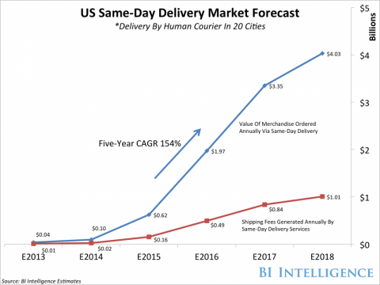
E-Commerce Giants Are Battling To Own The 'Last Mile'
“Companies like Google, Amazon, eBay, and Uber are operating and expanding services that allow shoppers to order something online and have it that same day, without ever leaving home.”
http://www.businessinsider.com/e-commerce-and-same-day-delivery-2014-9#ixzz3YcURiM1C

Slide 32
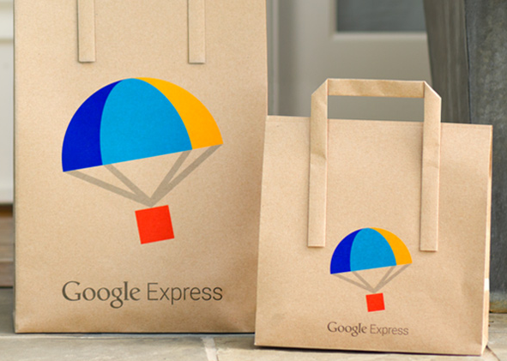
Google Express Value Prop
Great stores delivered to your door
Same-day delivery on everything you love
Free delivery on eligible orders over $15*
San Francisco Manhattan
Peninsula & San Jose Chicago
West Los Angeles Boston
Washington, DC

Slide 33
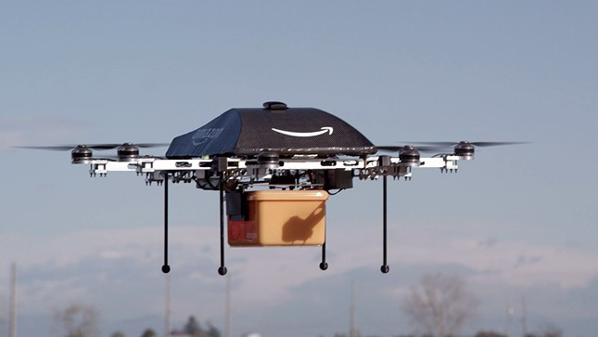
Amazon's plea to feds: Let drones deliver
4/27/15
Amazon is asking the Federal Aviation Administration to loosen its proposed rules for commercial drones so the company can use the devices to deliver packages that weigh less than 55 pounds….
http://thehill.com/policy/transportation/240144-amazon-presses-feds-to-loosen-drone-regs

Slide 34
E-Commerce Giants Are Battling To Own
The 'Last Mile'
11/4/14
“Companies like Google, Amazon, eBay, and Uber are operating and expanding services that allow shoppers to order something online and have it that same day, without ever leaving home.”
“If they manage it, despite the expense and complexities involved in delivering over the ‘last mile,’ these companies will grow e-commerce's customer base (as well as its share of retail dollars), and siphon off one of offline retail's last real competitive advantages.”

Slide 35
Key Points from the Report
USE: Today, 2% of shoppers living in cities where same-day delivery is offered have used such services. $100 million worth of merchandise will be delivered via same-day fulfillment this year in 20 US cities.
CONSUMER EXPECTATIONS: Consumer interest in same-day delivery is already fairly high. Four in 10 US shoppers said they would use same-day delivery if they didn't have time to go to the store, and one in four shoppers said they would considering abandoning an online shopping cart if same-day delivery was not an option.

Slide 36
Key Points from the Report
DEMOGRAPHICS: The most common same-day delivery shopper fits a very specific profile — millennial, highly likely to be male, urban-dwelling, and young. The products people want delivered same-day are also fairly niche.
BARRIERS: Despite all the competition in the same-day delivery market, it still won't be easy to get people to pay for these services. 92% of consumers say they are willing to wait four days or longer for their e-commerce packages to arrive.

Slide 37

Niche Products
These are not niche products.
Books, CDs, DVDs, and other media are native to their mix.

Slide 38
What have we learned?
Voter behavior is driven by “belief in” and “nostalgia about” libraries. Use doesn’t matter.
- 37% solid, 37% swayable, 25% no
Voters look to the “passionate librarian” as much as the “effective institution”.
Voters are consumers.
Marketing works.
Opposition must be engaged.

Slide 39
Thank You
John Chrastka
EveryLibrary
@mrchrastka @everylibrary

