Slide 1
ILL Best Practices: The STAR Checklist and Beyond Best Practices in Interlibrary Loans: The STAR Checklist and Beyond
Beth Posner
Head of Library Resource Sharing
CUNY Graduate Center Library (ZGM)
bposner@gc.cuny.edu

Slide 2
The Information Landscape
Technology
Print and Digital Information
Legal
Global
Economic

Slide 3
How have libraries responded?
Collecting vs licensing or single access payments
Digital and Print
Open Access/Institutional Repositories
Re-assigning staff, cross training and redeveloping job descriptions

Slide 4
How Has ILL Responded?
Buy vs Borrow
Consortial Partnerships
DD of Locally Held Info
Ref and BI
Report/Fix Cataolg and ERM Issues
Digitization of Special Collections

Slide 5
What are Best Practices?
One of many tools used to facilitate, educate, and advocate
Make the tacit explicit—codify standards and expectations
Provides a form of regulation/governance
Something to strive for…aspirational in nature
But also something that is achievable
An external, vetted resource to point to in order to advocate for more support (equipment, staffing, funding, etc.)
Good for those new to a field, who need direction/framework
Good for experienced practitioners as a guide for ongoing work

Slide 6
What About To Do Lists?
Daily
ILLiad queues
Borrowing - conditionals, unfilleds, awaiting requests, copyright, Awaiting Librarian
Lending – awaiting IDS lending, awaiting lending, renewal requests
Error Messages – although you can skip a day or two, doing some every day is easier!
Email messages (and phone messages)
Returns
Weekly
Special Messages (Borrowing and Lending)
Outstanding Requests web report
ILLIad Queues
Customer Notified twice queue – contact people in Customer notified queue who have not picked up items to see if they want a renewal or for us to return their item
Recalls (B and L)
Lost (B and L)
Make sure circulation area is in order
Questions shelf
Monthly
Stats
Semester
Annually
Stats
CCC Report
Ongoing Projects
Breaking the user link – purging ILLiad patrons or just decoupling names
GIST and Gift & Deselection Manager

Slide 7
And Checklists?
The Checklist Manifesto
Atul Gawande
Medical applications
Encourage communication
Specialization
A lot to remember
Include everyone
Get things done

Slide 8
Examples of ILL Best Practices

Slide 9
IFLA

Slide 10
IFLA Guidelines for Best Practice in Interlibrary Loan and Document Delivery
GENERAL RECOMMENDATIONS
Streamline the process within your own library
Define performance indicators for service levels and turnaround time and monitor your performance against them
Evaluate your own routines and change them accordingly
Reduce the number of hands through which the requests are passing
All requests should be handled in one electronic system, preferably with the ability to interoperate with other ILL/DD systems
Keep statistics to suit national monitoring schemes and local needs
Make holdings available on Union Catalogues and keep them up-to-date, with an indication of availability for resource sharing
Explore reciprocal arrangements
STAFF
Use the expertise of skilled staff members
Staff members should continuously be able to develop competencies and be trained in using new tools and resources
Encourage the exchange of experience at the local or international level
TECHNOLOGY
Hardware and software must be up-to-date
Encourage users to submit requests electronically
Give the end users the ability to check the status of requests online
Handle all communication about requests electronically
USERS
Focus on the needs and preferences of the end user
Perform user surveys on a regular basis

Slide 11
IFLA
RECOMMENDATIONS FOR THE SUPPLYING LIBRARY
Use experienced staff to collect requested material from your collections in order to minimize mistakes
Use the fastest delivery methods
Try to satisfy requests in the best possible way
Be sure that your license agreements for your e-resources will allow ILL/DD
Create online order forms and/or interoperate with other ILL/DD systems
Make your library's lending policies available on your web site and in policy directories
Accept IFLA vouchers
RECOMMENDATIONS FOR THE REQUESTING LIBRARY
ILL should be an integrated part of the Library's service to users
Introduce new technology in all processes
Do not limit unreasonably the number of requests from users
Involve the end user as much as possible in requesting
Give end users access to union catalogues with requesting facilities
Process requests from end users quickly
Use your experience to select supplying libraries according to speed of service and cost
Adhere to conditions of suppliers and treat material with care
Offer IFLA vouchers as payment
Deliver the material as fast as possible to the end user
Send copies electronically if at all possible
Check speed of supply on a regular basis

Slide 12
American Library Association

Slide 13
American Library Association
Reference and User Service (RUSA)
Sharing and Transforming Access to Resource (STARS)
ILL Code
STAR Checklist
Interlibrary Loan Practices Handbook
2011, Third Edition

Slide 14
ALA RUSA webinar
Interlibrary Loan 101: April 22 - May 19, 2013 Live Sessions on Mon and Wed, 1-2p.m. Central Time
Topics covered: ILL process, policies and procedures from both the borrowing and lending perspectives, copyright law and licensing impacts on ILL, and ILL resources and systems. Participants will learn standard practices, gain an overview of emerging trends, and practice writing policies for interlibrary borrowing and lending.

Slide 15
The IDS Project

Slide 16
IDS Project
Best Practices Institute
http://www.idsproject.org/Tools/BestPractices.aspx
Held during the 2011 IDS Conference
Borrowing: Request Processing: Automation & Strategies
Borrowing: Effective Post-Receipt Workflow
Borrowing: Special Messages & Connection Manager
Document Delivery: Sustainable Workflow
Lending: Setting a Solid Foundation
Lending: Improving Workflow without Sacrificing Quality
Workbook
Download the workbook (pdf, 10MB).
View the workbook's accompanying links.

Slide 17
Rethinking Resource Sharing Initiative

Slide 18
Rethinking Resource Sharing Initiative Manifesto
Restrictions shall only be imposed as necessary by individual institutions
Library users shall be given appropriate options
Global access to sharable resources shall be encouraged
Sharable resources shall include those held in cultural institutions of all sorts
Reference services are a vital component to resource sharing and delivery
Libraries should offer service at a fair price
Library registration should be as easy as signing up for commercial web based services.
Notes:
#1 Restrictions shall only be imposed as necessary by individual institutions with the goal that the lowest-possible-barriers-to-fulfillment are presented to the user.
2 Library users shall be given appropriate options for delivery format, method of delivery, and fulfillment type, including loan, copy, digital copy, and purchase.
3 Global access to sharable resources shall be encouraged through formal and informal networking agreements with the goal towards lowest-barrier-to-fulfillment.
4 Sharable resources shall include those held in cultural institutions of all sorts: libraries, archives, museums, and the expertise of those employed in such places.
5 Reference services are a vital component to resource sharing and delivery and shall be made readily accessible from any initial "can't supply this" response. No material that is findable should be totally unattainable.
6 Libraries should offer service at a fair price rather than refuse but should strive to achieve services that are not more expensive than commercial services, e.g. bookshops.
7 Library registration should be as easy as signing up for commercial web based services. Everyone can be a library user.

Slide 19
The STAR Checklist of Best Practices in Library Resource Sharing

Slide 20
Brought to you by ALA and RRSI
American Library Association
Reference and User Service
Sharing and Transforming Access to Research
>15 Committees
Rethinking Resource Sharing Policies
The Rethinking Resource Sharing Initiative
Ad Hoc, Grass Roots, and International
Facilitate, educate, advocate by speaking, helping to organize conferences and forums
Guided by committees structure
Steering Committee
Four Working Groups
Delivery
Interoperability
User Needs
Policies
Conference Planning
Innovation Award

Slide 21
The Rethinking Resource Sharing STAR Checklist
64 Items
Relevant for various types/sizes of Resource Sharing operations
Three Possible Answers to Each Question
We Do This Now (2 points)
We Plan On Implementing This in the Next Twelve Months
(1 point)
We Do Not Do This (0 points)
Points add up to one to four stars, reflected on the Certificate
http://rethinkingresourcesharing.org/checklist.html

Slide 22
Why Use this Checklist?
Gives library staff an opportunity to review and reflect on the policies and processes that comprise the resource sharing service they provide.
Also give them an outside source to show administrators what they should and could be doing with adequate support.
Designed to be aggressive, challenging library decision-makers to live on the front lines of rethinking resource sharing. There is no expectation that a single library will meet every item in the list, but achieving STAR status should be attainable.
Next step is to add a toolkit so that if your library is not doing something you can learn more about how to implement it.

Slide 23
Scoring
The highest possible score is 128. There are four STAR levels:
1 STAR: Participating libraries that are score between 77 and 89 points are engaged in 60%+ of activities/initiatives/services/policies represented in the Checklist and qualify for one STAR.
2 STARS: 90-101 points reflect engagement in 70%+ of activities/ initiatives/services/policies
3 STARS: 102-114 points reflect engagement in 80%+ of activities/ initiatives/services/policies
4 STARS: 115+ points reflect engagement in 90%+ of activities/initiatives/services/policies

Slide 24
What does getting a STAR (or 2 or 3 or 4) mean? ☺
Your library is at the forefront of resource sharing, or as we say, you are a resource sharing star
Do your patrons and administrators and colleagues know that?
Display your certificate and let them know so they can appreciate it and continue to support you!
If you get less than 4 stars – which is what most of us will get – you can use it as a tool to keep rethinking.

Slide 25
What if you get NO Stars? ☹…☺
Although it is possible that your staff is unmotivated, this is often because your department is not being supported with enough budget, staff, training, or technology to do all that is now possible.
So, use this as a way to start a discussion with administrators about what you need and why.
Not everything may be appropriate for every library, but most of us can do more if we rethink things.
Change is hard but staff can be encouraged to do so if you show that it is necessary and possible to change.

Slide 26
Ease of Resource Sharing Transactions Between Libraries
1. Library provides online request form for other libraries
2. Library accepts fax or email requests from other libraries
3. Library accepts requests within OCLC WorldCat Resource Sharing or other union catalog
4. Library's holdings are up to date in resource sharing systems
5. Library's serials holdings are up to date within a year in resource sharing systems
6. Library generally responds to/updates lending and borrowing transactions within 24 hours

Slide 27
Ease of Resource Sharing Transactions Between Libraries (cont.)
7. Library accepts requests through regional or consortial systems
8. Library participates in local or regional courier services whenever possible to deliver materials
9. Library’s lending policies are up to date with current information, including contact information and posted within the resource sharing systems utilized
10. Lending library uses ISO compliant system
11. Library is a member of a consortium with a shared catalog or discovery system

Slide 28
Ease of Identifying Materials
12. Library promotes use of plug-ins/widgets for identifying and locating library materials. Example: the LibX Toolbar
13. Holdings are discoverable in Worldcat - www.worldcat.org
14. Library utilizes OpenURL to help users connect to resources
15. Library provides links to digitized collections in the local ILS
16. Library utilizes federated search or other tool for cross-collection searching by users
17. Library’s electronic collections holdings are up to date in the local catalog

Slide 29
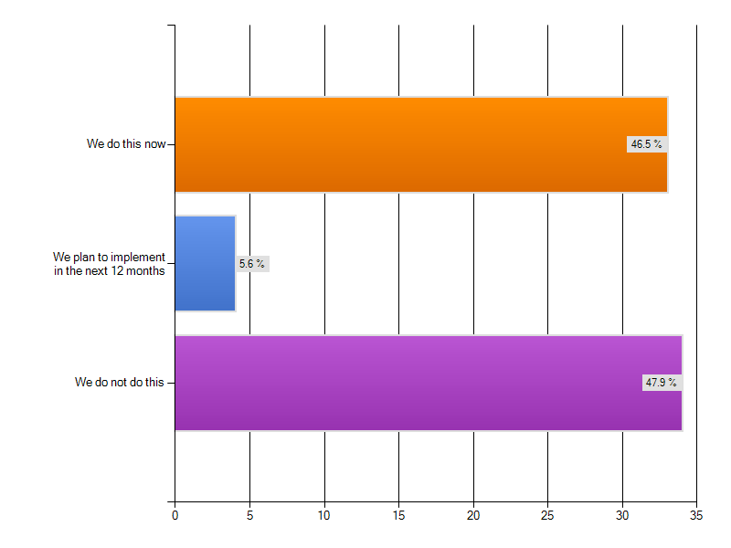
Promote discovery via widgets, other means?

Slide 30
Ease of Requesting for Borrowers
18. Library provides an online request form
19. Library processes user requests within 2 business days
20. Library has enabled automated request features in their catalog or discovery tool
21. Library has enabled unmediated resource sharing requests by users
22. Library utilizes OpenURL resolvers to make requesting items easier

Slide 31
User Friendly Services
23. Library provides online status of requests for users 24/7
24. Library’s borrowing policies and procedures are posted for users
25. Lending library has extended loan period (>30 days)
26. Library provides timely notification of impending due dates to users
27. Library utilizes interlibrary loan to request items in use by other users
28. Library loans non-returnable items to libraries outside of home country

Slide 32
User Friendly Services (cont.)
29. Library loans returnable items to libraries outside of home country
30. Borrowing library sends requests to libraries outside of home country
31. Lending library offers incentives for early return of materials in addition to or instead of overdue fines
32. Library loans new items
33. Lending library allows unlimited renewals for items not needed locally
34. Library makes every effort to loan unique items
35. Library provides same level of service to all users

Slide 33
User Friendly Services (cont.)
36. Borrowing library considers buy-on-demand before sending requests to library suppliers
37. Loaned returnables are not recalled; needed items are requested from other suppliers
38. Borrowing library offers patrons options to select location for delivery of requested returnable items
39. Borrowing library allows for direct delivery of returnable materials from the lending library to the end user
40. Lending library provides direct delivery of non-returnable items to the end user via online delivery, email, or other means

Slide 34
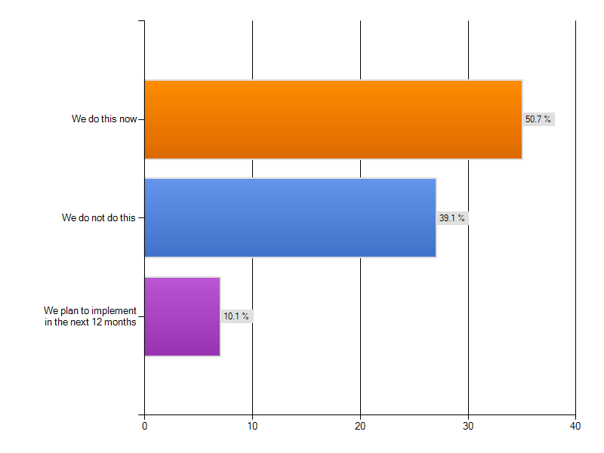
Consider buy-on-demand?
Information deluge
Discovery everywhere (open web, library resources)
Find more, want more
Find more, want more, request more
Increase in resource sharing
Notes:
Best practices in fair use summary

Slide 35
User Friendly Services (cont.)
41. Borrowing library allows for remote (online or phone) renewals of materials
42. Library conducts end-user needs assessments
43. Library has online means to register for local interlibrary loan service
44. Library has a service declaration in place and publicly posted committing to a minimum standard of resource sharing service for customers

Slide 36
Access to a Wide Variety of Formats
45. Lending library acquires copies of locally created dissertations to circulate/share
46. Library loans microforms
47. Library loans A/V materials Examples: CDs, DVDs, or VHS
48. Library digitizes items that cannot be loaned physically, within the confines of copyright and other legal restrictions
49. Library seeks methods to share public domain content digitally
50. Library loans old, bound journals

Slide 37
Electronic Materials
51. Library staff is aware of the sharing permissions of the licensed content at the library
52. Resource sharing staff provide input on license language for electronic content acquired by the library

Slide 38
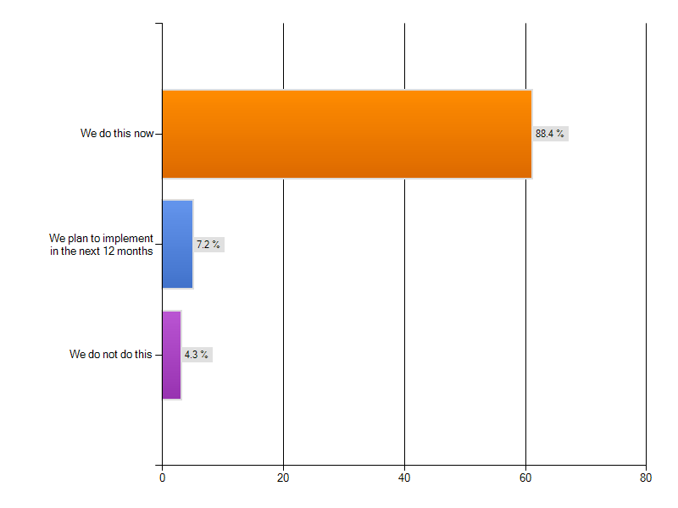
Knowledge of permissions?

Slide 39
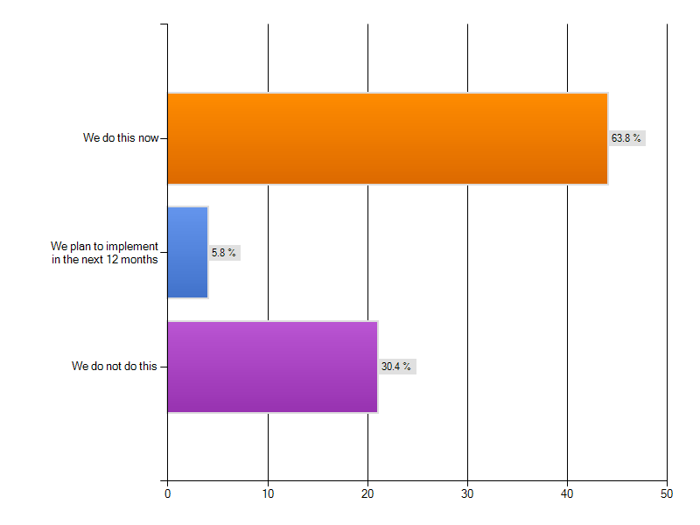
Input on license negotiation
Notes:
Best practices in fair use summary

Slide 40
Fees
53. Lending library allows free sharing of materials whenever possible
54. Lending library charges reasonable fees that encourage, versus discourage, resource sharing
55. Lending library distinguishes fees for unique materials
56. Lending library staff has option to waive fees to encourage supply of materials
57. Borrowing library will contribute to costs of scanning unique items that cannot be loaned physically
58. Library uses OCLC IFM and/or DOCLINE EFTS to manage fees

Slide 41
Fees (cont.)
59. Library uses IFLA vouchers
60. Library participates in reciprocal agreements with other libraries
61. Library accepts credit cards for payment of transaction fees
62. Library has credit card for staff use to obtain materials from commercial suppliers for users
63. Library does not charge its library cardholders for basic ILL service
64. Library serves independent scholars who are guests of the institution

Slide 42
STAR Checklist evolution
Next Iteration of the Checklist
Emerging best practices/guidelines surrounding:
Privacy
Green/sustainable business practices
Professional development and continuing education
Volunteer/student management
Assessing user behavior, service delivery, trends to feed collection development strategy, and more
Providing research assistance/user instruction
Future - Toolkit
The next phase of the Checklist involves hyperlinking to more information about how to implement each item

Slide 43
Thank You!
For More information:
Rethinking Resource Sharing team
resourcesharingstar@gmail.com
ALA RUSA STARS
http://www.ala.org/rusa/sections/stars
Beth Posner
bposner@gc.cuny.edu

