Slide 1
What if I’m a referral centre?

Slide 2
Contact – starckc@oclc.org

Slide 3
What if I use ILLiad?

Slide 4
What if I use ILLiad?
ILLiad users don’t need to do anything to begin with.
If you access WorldCat Resource Sharing, you will continue to do so.
9 digit authos do not work with WS ILL
ILLiad libraries that want access to the WS ILL interface will require a *new* username and password
Some new features from WorldShare ILL will be available in ILLiad version 8.4.x. So you should start planning your Summer upgrade.
OCLC and Atlas Systems will end customer support for ILLiad versions 8.1 and 8.2 on June 30, 2013

Slide 5
WorldShare ILL and ILLiad
If you want to use WorldShare ILL in the same way as you currently use WorldCat Resource Sharing, you will be able to in the summer.
WorldCat Resource Sharing on FirstSearch will be switched off in December 2013.

Slide 6
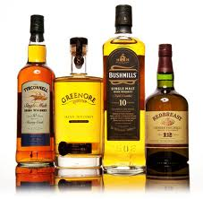
What does WSKey mean to you?
WSKey = Web Service Key

Slide 7
OCLC Web services in ILLiad 8.4
Article Exchange upload
Article Exchange download
IFM web service for CCC’s Get It Now
Policies
Directory

Slide 8
http://www.worldcat.org/config/
Notes:
And select Request Key

Slide 9
Notes:
Select Article Exchange, Interlibrary Loan Policies and soon IFM.

Slide 10
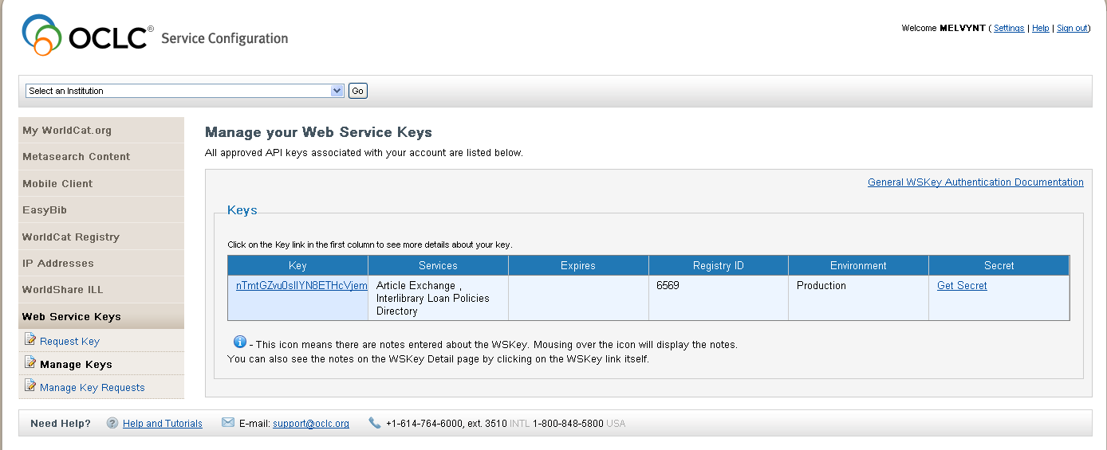
Notes:
Once you log back into Service Config select manage key. You will see your key. Click on Get Secret

Slide 11
Notes:
In ILLiad Customization Manager add your WSKEY and Secret.

Slide 12
Get It Now Overview
Provides just-in-time fulfillment of journal content
Augments an ILL operation
Developed in cooperation with the California State University System and the IDS Project
Over 9,000 journals and growing
Adopted by over 160 campuses
Fee per article only; no additional fees
Mediated and unmediated versions

Slide 14
Get it now/IFM roll out
Must be running ILLiad 8.4
Pilot with 8 libraries in June and July
Commercially available on August 1
To make GIN go you will need your ....

Slide 15
Update your constant data
Please!

Slide 16
It takes a vILLage!

Slide 17
The good, the bad, and the ugly about Constant data
OCLC Resource Sharing and ILLiad libraries must modify their constant data records for all Shipping fields for the launch of WorldShare ILL.
Failure to do so will result in WorldShare ILL libraries having major issues with address labels.
Numbers must be used when using number fields!

Slide 18
The Good

Slide 19
The Bad

Slide 20
The UGLY
Address labels will print like this:
OCLC/6565 Kilgour Place/Dublin, OH. 43017
Not like this:
OCLC
6565 Kilgour Place
Dublin, OH 43017

Slide 21
The good the bad and the ugly about Constant data
Numbers must be used when using number fields!

Slide 22
I’m ready! What next?

Slide 23
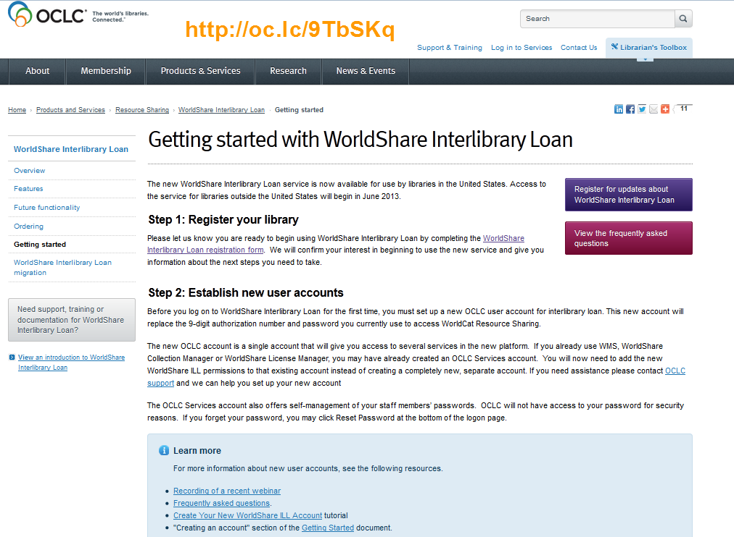
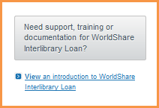
I’m Ready ! What Next?
Notes:
Training
Getting started
Borrowing
Lending

Slide 24
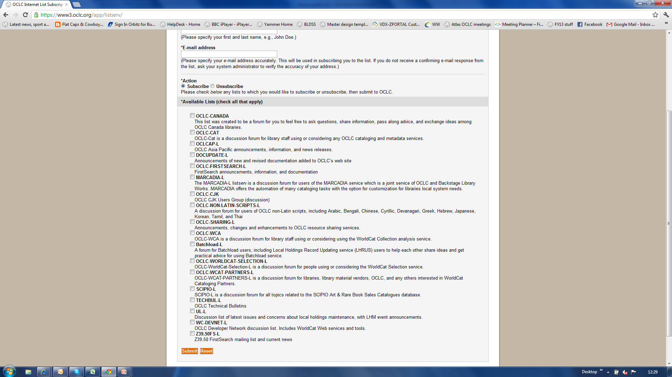
Keep up to date
Discovery OCLC-FIRSTSEARCH-L
Delivery OCLC-SHARING-L
https://www3.oclc.org/app/listserv/

Slide 25
Timeline
March-December 2013: Open migration to WorldShare Interlibrary Loan (in U.S.)
** Libraries that use patron-initiated ILL-good to go**
November 2013: End of new requests in WorldCat Resource Sharing
2013
June-September 2013: Non-U.S. WorldCat Resource Sharing subscribers migrate to WorldShare Interlibrary Loan
December 2013:End of access to WorldCat Resource Sharing
Notes:
Because the new discovery interface is going to take longer than planned we’ve allowed for patron requesting on FS and WCL to work with both WCRS and WS ILL
Just over 1,000 registrations so far

Slide 26
Things to do?
Subscribe to sharing-l and firstsearch-l
Update your constant data please!
WorldCat Resource Sharing:
Get ready! Register! Start using!
ILLiad
Get your upgrade scheduled.
Request your WSKey and Secret in preparation for ILLiad 8.4
Look out for announcements about when you can get your username and password for WorldShare ILL
Clio
Contact Clio or Ex Libris about your upgrade

Slide 27
Transforming ILL What OCLC's WorldShare will mean to you
Katie Birch
Portfolio Director
birchk@oclc.org

