Slide 1
Article Exchange

Slide 2
Who is still using Ariel?

Slide 3
Article Exchange – documents uploaded
Notes:
903 institutions in 17 countries have used the service

Slide 4
Countries using Article Exchange

Slide 5
Article Exchange Web service – upload and download
Web Services
Minitex –
March – 1,764
February – 1,843
January – 1,355

Slide 6
Scanners and Article Exchange
Available now
http://www.youtube.com/user/ScannxBookScanCenter
BookScan Station Licensees from April 1 2013
BSCAN ILL line of products is scheduled for release in summer 2013

Slide 7
Looking at the Future of WorldCat on FirstSearch

Slide 8
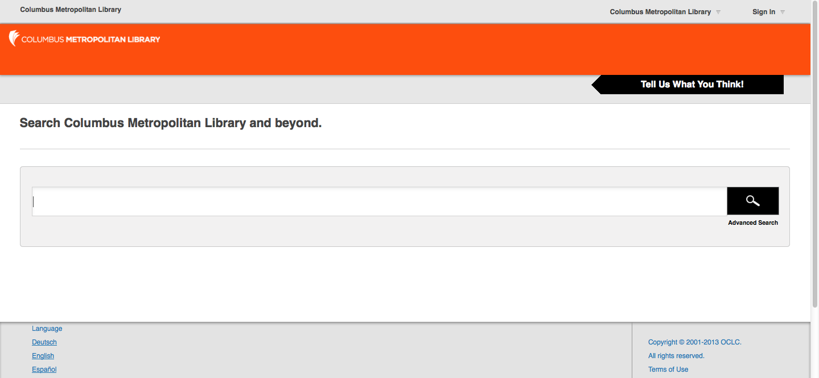
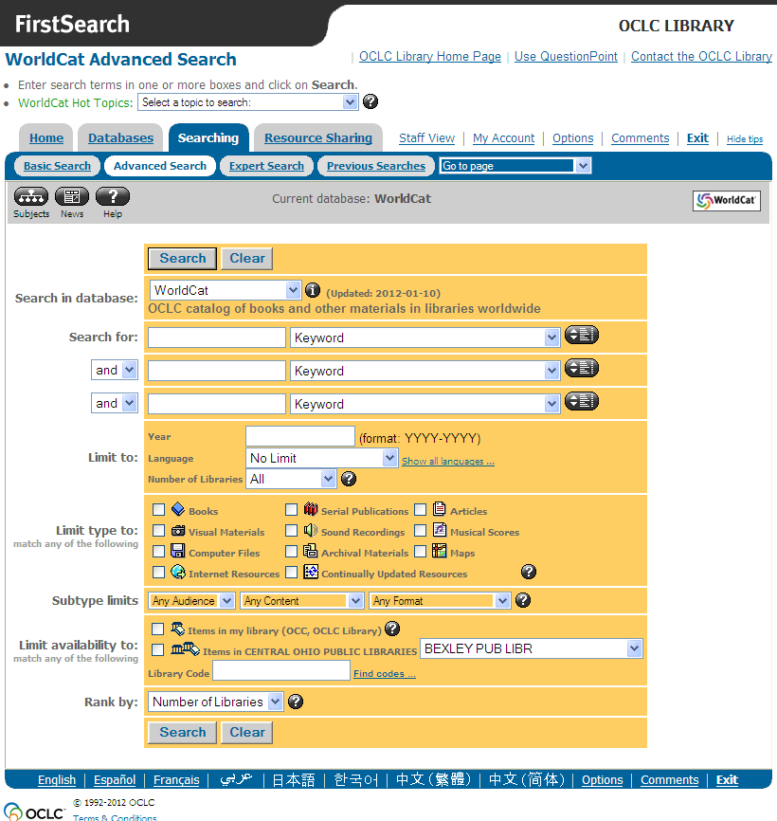
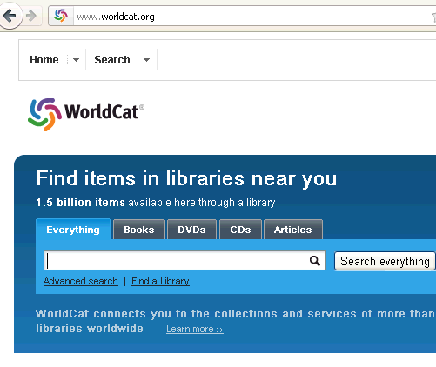
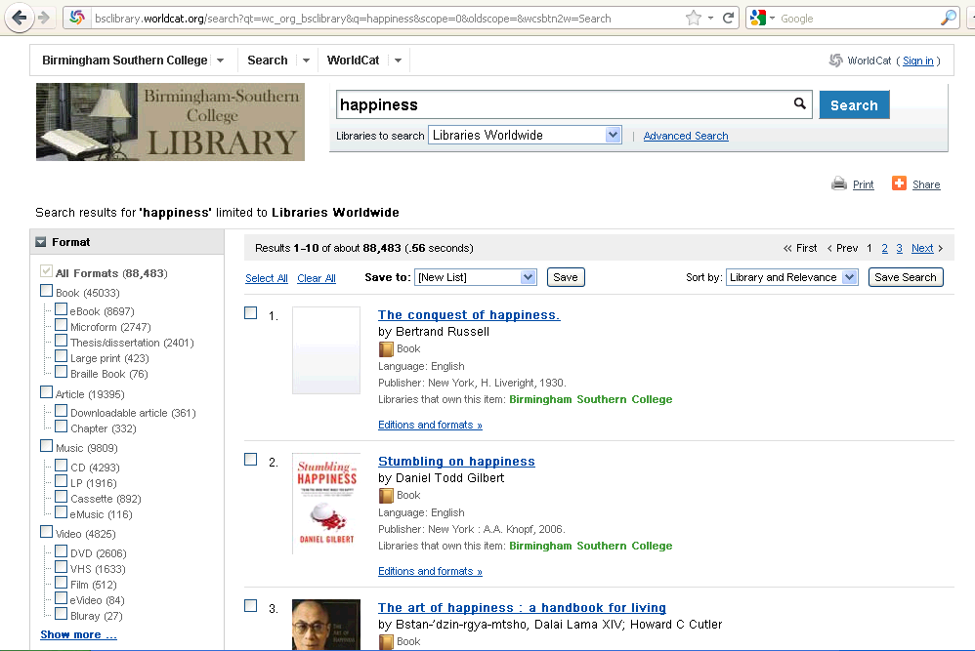
Consolidating interfaces
Single Discovery interface—multiple views, functionality
FirstSearch
WorldCat Local
WorldCat.org
Notes:
I want to stop here and make sure it’s clear: what you’ve just seen is the staff view of the future Discovery service, that will eventually replace all the current interfaces for FirstSearch, WorldCat.org and WorldCat Local.

Slide 9
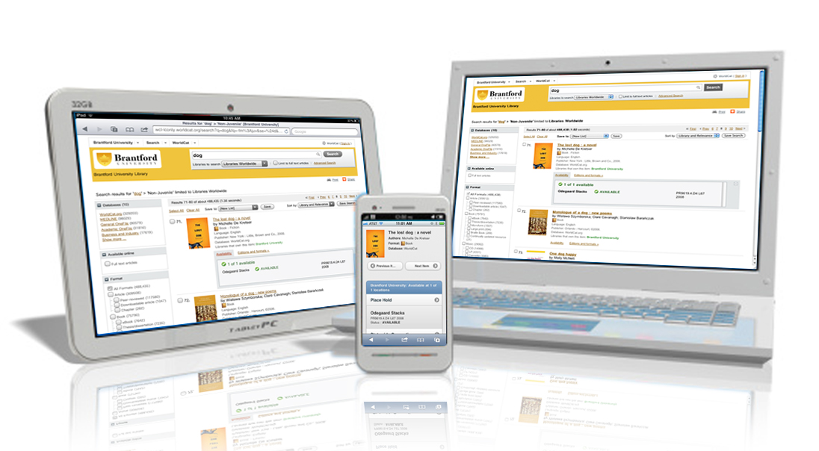
Access across devices
Notes:
Addressing the issue of access on Desktop, Tablet and mobile devices

Slide 10
Open Beta
Who has been invited?
Unlimited and port limited subscribers
When?
28 February 2013 - wayc@oclc.org
Goal of the beta
Assure librarians have input into the interface and it meets their needs to remain part of their workflow and aim to make their workflow more efficient
Insure patrons also have input and the interface and it meets the need to provide an interface for patron initiated ILL and discovery of items outside the library system

Slide 11
Migration
What is the goal of the migration?
Provide an updated interface that adds new efficiencies and capabilities to your workflow
Introduce a single interface design between FirstSearch, worldcat.org, and WorldCat Local
When will the migration begin?
July 1 is the target date

Slide 12
CO Libraries participating in the beta
Boulder Public Library
Pikes Peak Community College
Colorado State University
Colorado Mental Health Institute at Pueblo
University of Northern Colorado
Pueblo City County Library District
AORN
Saint John Vianney Theological Seminary
Lafayette Public Library
Westminster Public Library
Bureau of Reclamation

Slide 13
WorldShare ILL

Slide 14
WorldShare ILL
WorldShare ILL was launched on 12 March 2013.
More than 1,000 registrations to date.
http://www.oclc.org/en-US/worldshare-ill.html

Slide 15
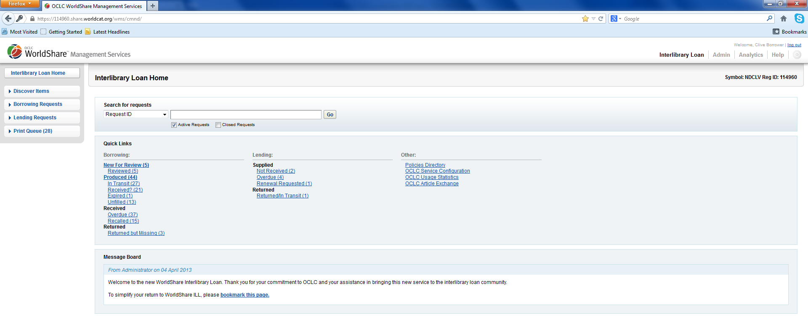
WorldShare ILL
WorldShare ILL replaces WorldCat Resource Sharing.
(aka OCLC ILL, ILL on FirstSearch..)

Slide 16
ILL functionality in the FirstSearch admin module will move to the OCLC Service Configuration tool
http://www.worldcat.org/config/

Slide 17
Browser versions – Supported baseline following 12th May install
FireFox 20.0
Tested version is best
IE9
IE8
IE7 – Not supported
Chrome 26.0.1410.43 m
Tested version is best
If you are not sure what browser or version you are using, go to http://www.thismachine.info/

Slide 18
Authentication
Your FirstSearch 9 digit autho will not work with the new service.
You will have to go through a new, web-based process to create a username and password.
Each institution will have its own individual URL.

Slide 19
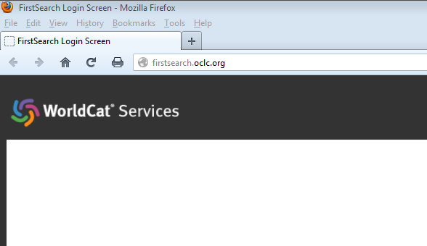
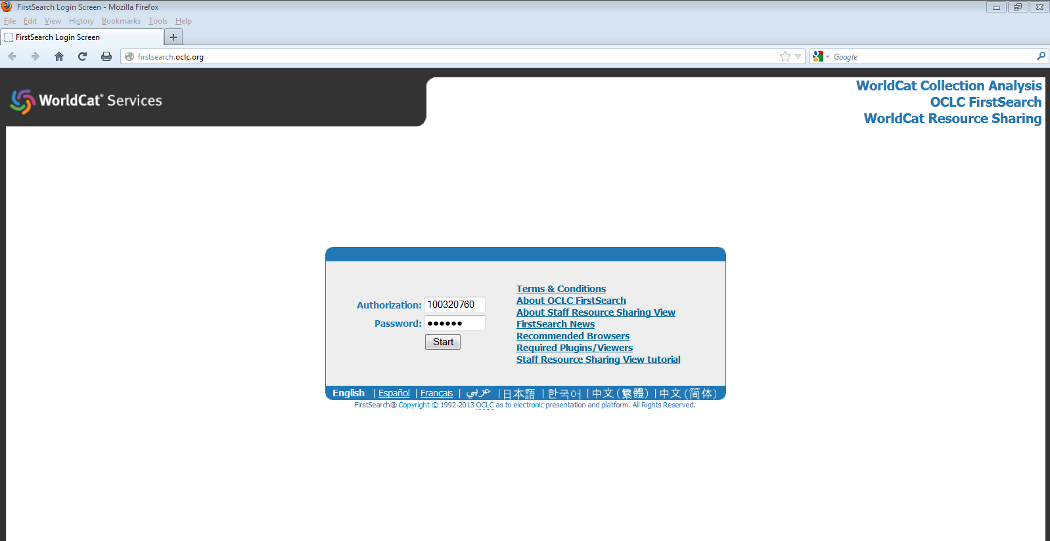
Old login

Slide 20
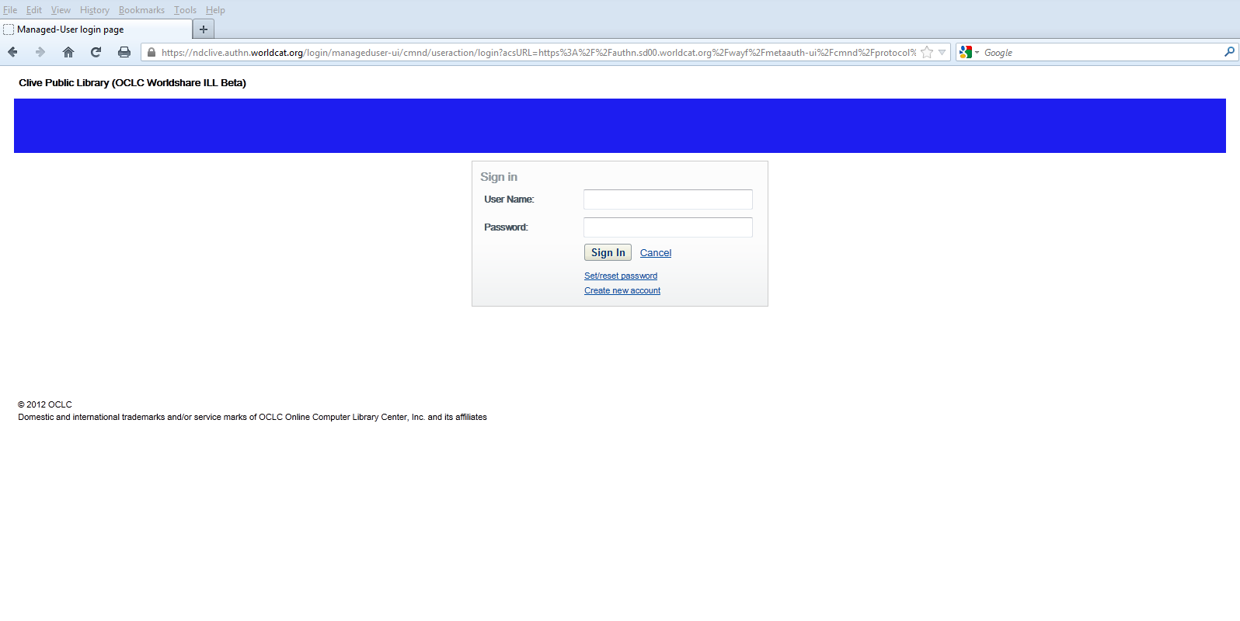
New login

Slide 21
How to migrate?
Libraries can use both WorldCat Resource Sharing and WorldShare ILL at the same time throughout the migration period (because the underlying database is the same).
So think about starting small –
Doing borrowing or lending in WS ILL
Or
On Tuesdays or Fridays for example

Slide 22
Roadmap? http://oc.lc/3Bhn3x

Slide 23
Future roadmap: NEW features in WorldShare ILL
http://oc.lc/3Bhn3x
First pass buy it workflow
Tight integration with Article Exchange
Displaying links to open access resources
Display supplier cost information in holdings display
Changes to support variable lender ageing (EMST)
Indicators in staff work form and holdings display

Slide 24
What if I use Clio?

Slide 25
Clio 6.7.1.
You must upgrade to version 6.7.1 by 01 July 2013
Older versions of Clio will not work as of 01 July 2013
WS ILL is optional, if you want to use WS ILL
You may register to use WS ILL and look around.
Do not action requests in WS ILL if you have not upgraded to 6.7.1
Contact: Clio Technical Support or Ex Libris
Email support@cliosoftware.com or call 817-726-3475

