Slide 1
Transforming ILL
Colorado ILL, Friday 19 April
What OCLC's WorldShare will mean to you
Katie Birch
Director – Delivery Services

Slide 2
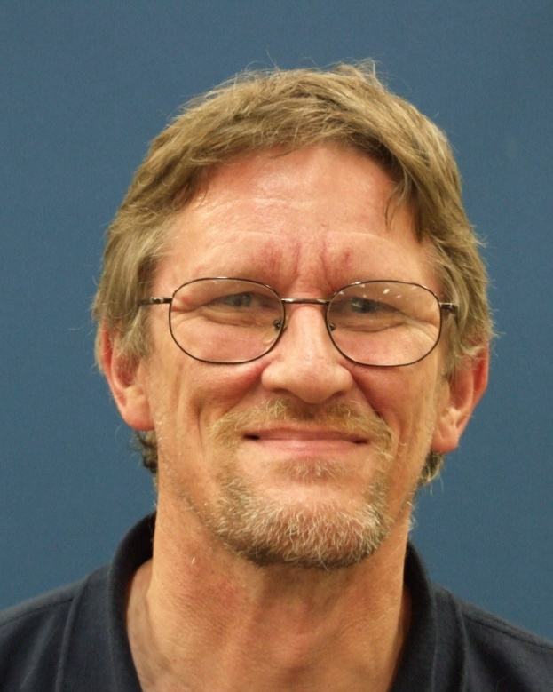
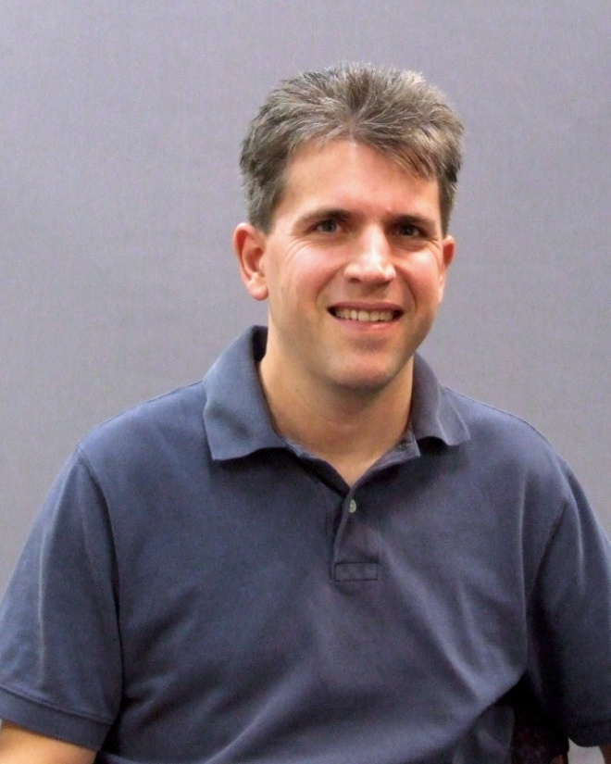
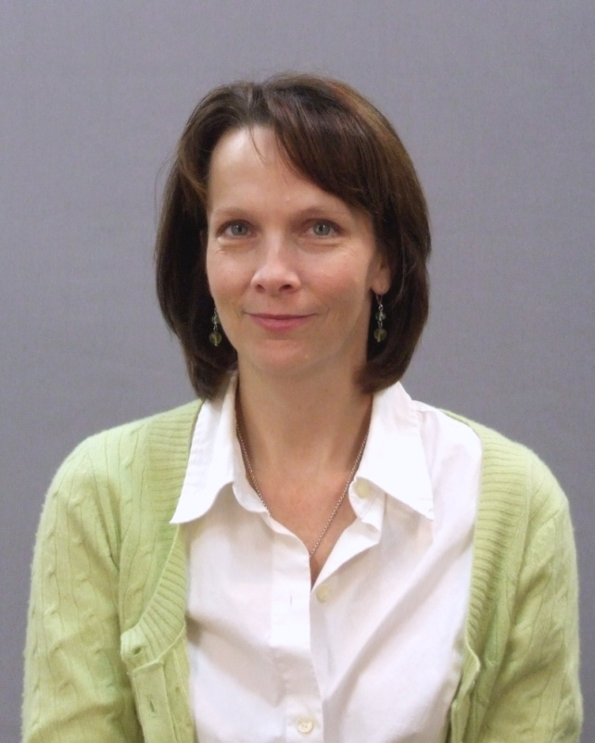
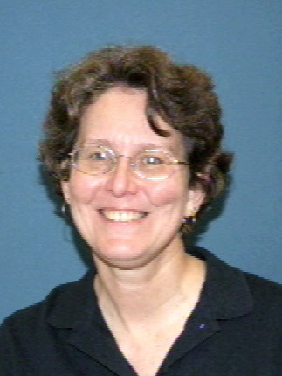
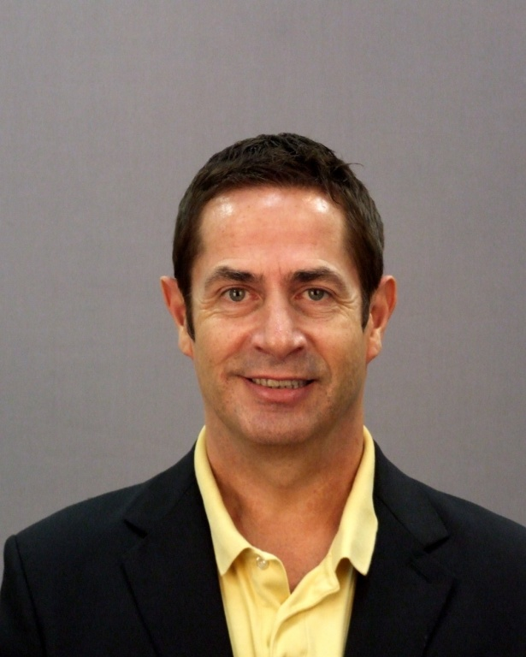
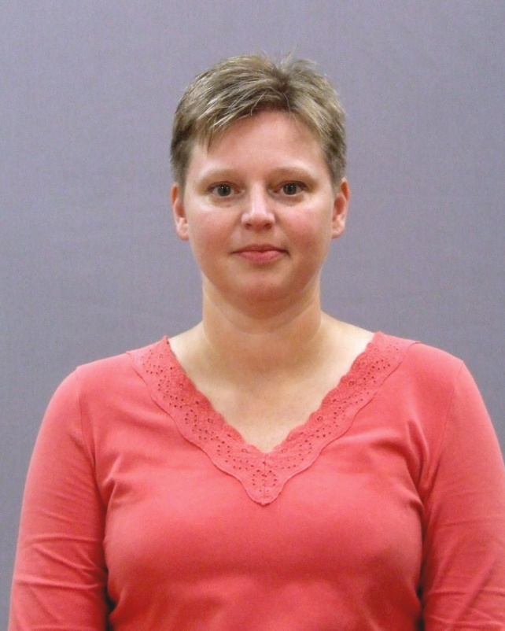
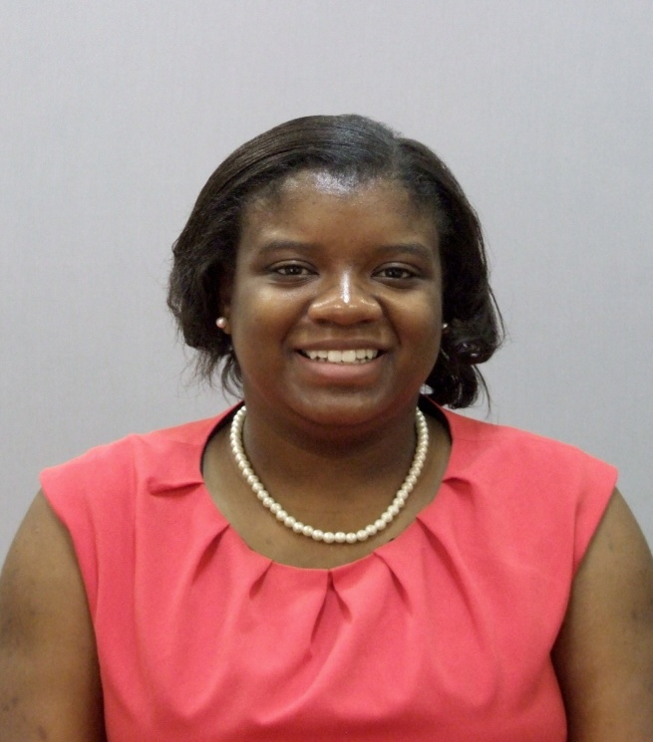
Delivery Services team
Tony Melvyn - WorldCat Resource Sharing
Christa Starck – WorldShare Interlibrary Loan
Julie Nye – WorldShare Interlibrary Loan
Jennifer Corsi – Policies Directory
// WorldShare Interlibrary Loan
Ed Davidson – Navigator // VDX
John Trares – ILLiad Hosting
Kendra Parson – OCLC Diversity Fellow

Slide 3
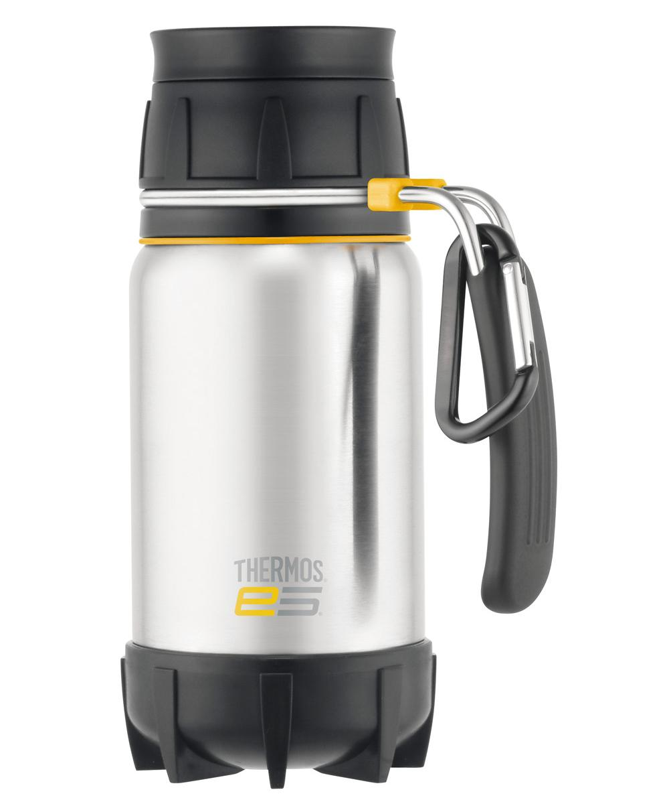
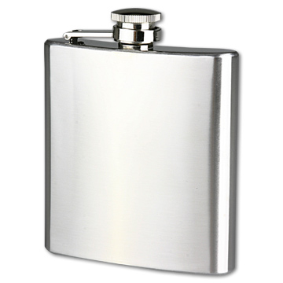
“England and America are two countries separated by a common language” - George Bernard Shaw

Slide 4
Today’s topics
Most requested titles
GEBAY
IFLA Vouchers
Article Exchange
FirstSearch
WorldShare ILL // ILLiad 8.4 // Clio

Slide 5
Most requested titles in FY12?
NUMBER 1
5299 Requests
Rank 2011 – #24
Rank 2013 YTD – #155
$2.02 Amazon price
NUMBER 2
4213 Requests
Rank 2011 – #39
Rank 2013 YTD - #129
$10.51 Amazon price

Slide 6
And more....
NUMBER 3
2606 Requests
Rank 2011 – #11
Rank 2013 YTD - # 110
$9.87 Amazon price
NUMBER 4
2486 Requests
New entry
Rank 2013 YTD - # 1
$9.33 Amazon price
Published 3 April 2012
Notes:
http://www.dailymail.co.uk/femail/article-2187022/Fifty-Shades-Of-Grey-Its-really-FIVE-Shades-analysis-reveals-finishes-bestseller.html

Slide 7
Top 10 requested titles in WorldCat Resource Sharing last FY
http://www.oclc.org/us/en/resourcesharing/statistics/default.htm

Slide 8
My predictions in November 2012
# 627
(Soundtrack!)
# 907
# 3

Slide 9
1 July 2012 – 31 March 2013

Slide 10
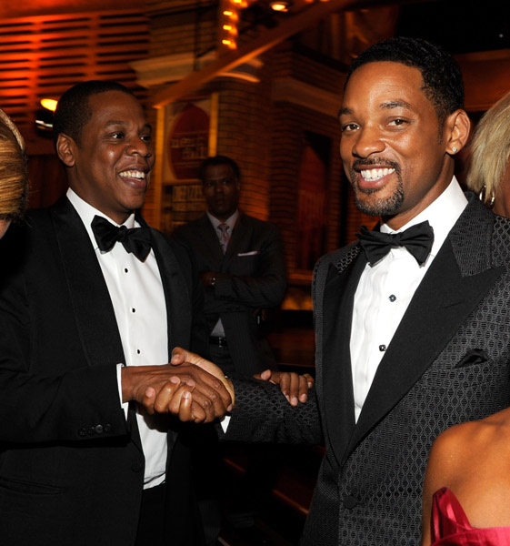
The 48 Laws of Power
2011 – 34th
2012 – 53rd
2013 – 34th

Slide 11
The 48 Laws of Power and ILL?
Law 18 – Do not build fortresses to protect yourself – Isolation is dangerous
Law 28 – Enter action with boldness
Law 29 – Plan all the way to the end
Law 35 – Master the art of timing

Slide 12
GEBAY
Bavarian State Library

Slide 13
GEBAY
http://oc.lc/93LYxb

Slide 14
46 libraries in the USA using MyBib eL

Slide 15
GEBAY – how?
Read the documentation - http://oc.lc/hhoJrf
Ask GEBAY for the activation link (up to 5 PCs)
Placing a request:
Use the SHIP VIA field – add MyBib eL
Include your email address in the email field
A delivery note will be sent via email
(Tighter integration is coming!)

Slide 16
IFLA Vouchers

Slide 17
IFLA Vouchers
http://oc.lc/dZbEL8

Slide 18
Buying vouchers
Full voucher: $ 12.00 CAN/US each (no shipping charge)
Half voucher: $ 6.00 CAN/US each (no shipping charge)
How?
Via order services or
VOUCH symbol in WCRS with a dummy request
Count September through March 15th -
1,806 Full Vouchers
520 Half Vouchers

